Slide 1






PLAN, TRIAL AND IMPLEMENT MINIMAL IMPACT OPERATIONS
D2.TTG.CL3.15
Notes:
Trainer welcomes students to class.

Slide 2
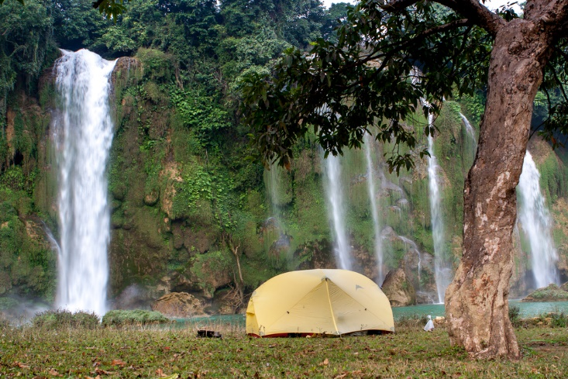
Plan, trial and implement minimal impact operations
This Unit comprises four Elements:
Plan minimal impact operations
Trial minimal impact operations
Implement minimal impact operations
Evaluate minimal impact operations
Notes:
Trainer advises trainees this Unit comprises four Elements, as listed on the slide explaining:
Each Element comprises a number of Performance Criteria which will be identified throughout the class and explained in detail
Trainees can obtain more detail from their Trainee Manual
At times the course presents advice and information about various protocols but where their workplace requirements differ to what is presented, the workplace practices and standards, as well as policies and procedures must be observed.

Slide 3

Assessment
Assessment for this unit may include:
Oral questions
Written questions
Work projects
Workplace observation of practical skills
Practical exercises
Formal report from employer/supervisor
Notes:
Trainer advises trainees that assessment for this Unit may take several forms, all of which are aimed at verifying they have achieved competency for the Unit as required.
Trainer indicates to trainees the methods of assessment that will be applied to them for this Unit.

Slide 4
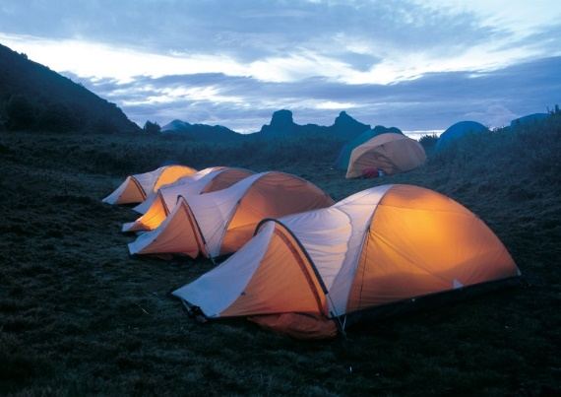
Element 1 – Plan minimal impact operations
Performance Criteria for this Element are:
Identify the proposed activity/operation to be conducted
Identify the location in which the identified activity/operation is proposed to be conducted
Research the factors that may be impacted by the proposed activity
Research the compliance requirements that apply to the proposed activity/operation and location
Develop a plan that details the experiences and activities to be implemented
Notes:
Trainer identifies for trainees the Performance Criteria for this Element, as listed on the slide.
Class Activity – General Discussion
Trainer leads a general class discussion by asking questions such as:
What is meant by minimal impact operations?
Why is it important to consider/learn about this?
What are some examples of it?
What are the possible problems associated with not implementing minimal impact tourism operations?

Slide 5

Identify the proposed activity/operation to be conducted
‘Minimal impact tourism’ = ‘Sustainable tourism’ – also known as:
Green tourism
Responsible tourism
Eco-tourism
Environmental tourism
Ethical tourism
Notes:
Trainer explains:
There is no single, universally-agreed definition of minimal impact tourism
In practice, it is known more commonly as ‘sustainable tourism’
It may also be referred to by other terms such as:
Green tourism
Responsible tourism
Eco-tourism
Environmental tourism
Ethical tourism.
Classroom Activity – Internet Research
Trainer facilitates research and discussion of:
http://www.tourism.australia.com/industry-advice/what-is-sustainability.aspx – regarding consideration of definition and social responsibility.

Slide 6

Identify the proposed activity/operation to be conducted
Critical aspects include the need for Tourism Operators to:
Avoid damage to the area visited
Minimise impact on the area visited
Repair previous damage
Notes:
Trainer highlights critical in the notion are Tourism Operators taking action to:
Avoid damage to the area visited
Minimise impact on the area visited
Repair previous damage.
Classroom Activity – Internet Research
Trainer facilitates research and discussion of:
http://www.iztzg.hr/en/odrzivi_razvoj/sustainable_tourism/ - What is sustainable tourism
http://www.unesco.org/education/tlsf/mods/theme_c/mod16.html - Sustainable tourism
http://www.sustainabletourism.net/ - Sustaining tourism.

Slide 7

Identify the proposed activity/operation to be conducted
ASEAN:
Is committed to sustainable tourism
Records this commitment in its ATSP
Notes:
Trainer emphasises ASEAN is committed to sustainable, with reference to The ASEAN Tourism Strategic Plan (ATSP) 2011- 2015.
“By 2015, ASEAN will provide an increasing number of visitors to the region with authentic and diverse products, enhanced connectivity, a safe and secure environment, increased quality of services, while at the same time ensuring an increased quality of life and opportunities for residents through responsible and sustainable tourism development by working effectively with a wide range of stakeholders”
emphasising:
“All strategic directions and actions in the ATSP are guided by responsible and sustainable tourism principles recognizing the significant role that tourism plays in poverty reduction, climate change, gender and minority issues, capacity building, cultural preservation and natural conservation.”
Classroom Activity – Internet Research
Trainer facilitates research and discussion of:
http://www.businesseventsthailand.com/fileadmin/user_upload/documents/mice-publications/Asean_Travel_Tourism.pdf
http://www.asean.org/resources/publications/asean-publications/item/asean-tourism-marketing-strategy-2012-2015-2 - ASEAN Tourism Marketing Strategy 2012 – 2015 (can be downloaded via link from this site)

Slide 8
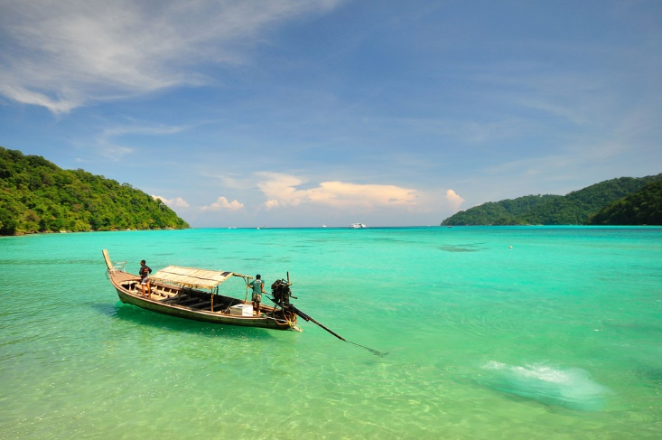
Identify the proposed activity/operation to be conducted
‘The industry’ is also committed to the concept as can be seen from APEC/PATA Code for Sustainable Tourism whose stance is:
“… to encourage and assist in the development of travel industries throughout Pacific-Asia in a manner which recognises the urgent importance to practice an environmental ethic that supports responsible conservation and restoration of Pacific Asia’s unique combination of natural, social and cultural resources”
Notes:
Trainer highlights the industry is also committed to sustainable tourism with reference to APEC/PATA Code for Sustainable Tourism which states in part its stance is:
“… to encourage and assist in the development of travel industries throughout Pacific-Asia in a manner which recognises the urgent importance to practice an environmental ethic that supports responsible conservation and restoration of Pacific Asia’s unique combination of natural, social and cultural resources”.

Slide 9

Identify the proposed activity/operation to be conducted
Tour Operators can demonstrate their commitment by: 1
Planning and trialling tourism operations for minimal impact before implementation
Notes:
Trainer explains within the construct of minimal impact/sustainable tourism (as described) individual Tourism Operators can demonstrate responsible practice by planning and trialling tourism operations for minimal impact before implementing them as standard practice in their business.
The first step in this process is the need to identify proposed activities or operations to be conducted so they can be:
Properly described and quantified
Geographically located
Researched to determine the factors that may be impacted by the proposed activity
Analysed to identify relevant compliance requirements that need to be met
Properly planned with reference to a suitable and detailed, written proposal and plan of action.
Classroom Activity – Guest Speaker
Trainer arranges for local Tour Operator to attend and:
Discuss their orientation to sustainable tourism
Explain how they demonstrate their commitment
Identify Codes and other arrangements/agreements they comply with as part of their commitment
Detail a sustainable tourism initiative they have introduced/been involved with.

Slide 10

Identify the proposed activity/operation to be conducted
Activities which may need to be planned in this context can include:
Constructing facilities
Introducing tours
Increasing tourist footprint
(Continued)
Notes:
Trainer identifies activities which may need to be planned as part of sustainable tourism/minimal impact tourism:
Constructing facilities – such as:
Access roads
Buildings
Infrastructure
Introducing tours – into areas where there was previously no tours
Increasing the tourist footprint – in terms of, for example:
Bringing in more visitors
Increasing the number of tours to the area
Increasing the duration of tours

Slide 11
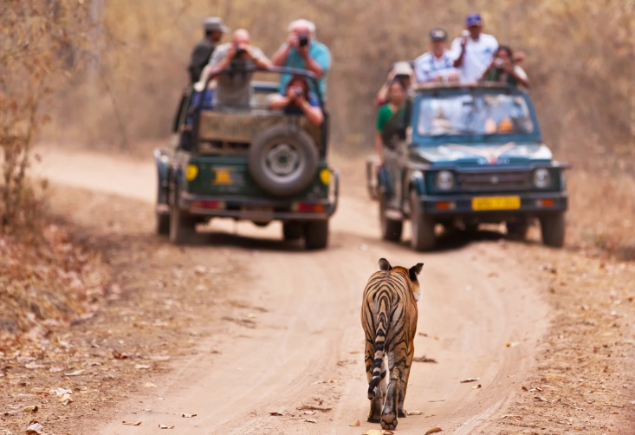
Identify the proposed activity/operation to be conducted
Introducing interpretive activities
Establishing camps
Interacting with wildlife
Notes:
Trainer continues to identify activities which may need to be planned as part of sustainable tourism/minimal impact tourism:
Introducing interpretive activities – which may require:
Access to new/different areas
Use of local resources
Involvement of local communities
Establishing camps – for over-night and/or longer stays where there will be a demand for:
Toilet and washing facilities
Cooking and eating facilities
Interacting with wildlife – as:
Part of a tour
Caused by tourist intrusion (camps; travel through regions) into their natural habitat.
Classroom Activity – Guest Speaker
Trainer arranges for local Tour Guide to attend and:
Discuss their orientation to sustainable tourism
Describe how they operate to comply with the principle of sustainable tourism
Indicate what they see as issues to consider when planning and introducing a sustainable tourism initiative.

Slide 12
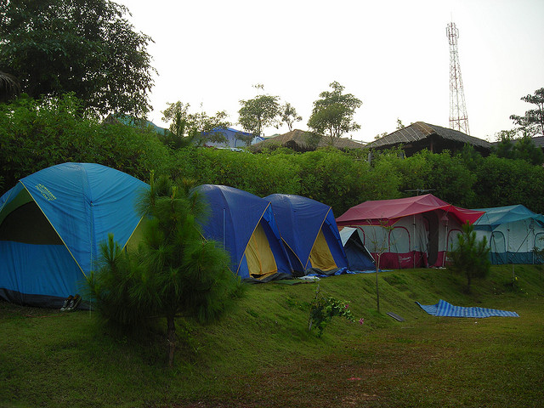
Identify location in which the identified activity/operation is proposed to be conducted
Step 1 in planning is to identify the location for the initiative – this refers to:
Describing the immediate geographic vicinity in which the activity/operation itself is proposed
Stating associated geographic locations that may be impacted by the activity/operation
Notes:
Trainer indicates an important first step in planning a sustainable tourism initiative is the need to identify the location of the tourism activity or operation highlighting this refers to:
Describing the immediate geographic vicinity in which the activity/operation itself is proposed – which may occur with reference to:
Specific latitudinal and longitudinal points
Name of country/countries
Local (recognised or generally accepted and understood) names –for towns, villages, communities, areas, regions, locales and/or points of interest
Geographic features – such as mountains, rivers, lakes, coastlines, islands and other prominent landforms
Stating associated geographic locations that may be impacted by the activity/operation – which may require specification of:
Camp sites not intrinsic to the proposed tour activity
Position of supporting facilities – such as parking and loading/unloading areas, airfields/landing areas, storage space for permanent plant and equipment, infrastructure,
Routes that will enable access (ingress and egress) to the activity/operation – including details of land, water and air travel.

Slide 13
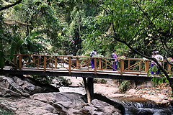
Identify location in which the identified activity/operation is proposed to be conducted
Exact location is necessary to:
Demonstrate transparency and openness
Ensure those potentially impacted can be made aware of the proposal
Make sure correct/necessary people are involved
Begin process of researching funding which may be available
(Continued)
Notes:
Trainer explains the exact location/s for proposed tourism activities and operations need to be correctly and specifically determined in order to:
Demonstrate transparency and openness in the proposal – which is an essential pre-requisite for generating genuine support and positive commitment to the initiative from all stakeholders
Ensure all those potentially impacted can be made aware of the proposal – and make whatever input or comment they believe is appropriate and relevant
Make sure the correct/necessary people (communities, locals, government agencies) are involved – and can be involved in the planning and subsequent stages
Begin the process of researching government funding which may be available for the area – to support sustainable/minimal impact tourism initiatives

Slide 14
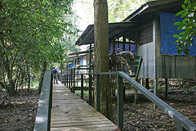
Identify location in which the identified activity/operation is proposed to be conducted
Research standard factors that may be impacted
Identify the country/countries involved
Start process of identifying other Tourism Operators who may be operating in the area
Enable identification of other non-legislated requirements which apply
Provide a real-world context for the written plan
Notes:
Trainer continues to explain need to identify location for initiative/s – in order to:
Research standard factors that may be impacted by the proposed activity – more later but standard classification of these factors include:
Environmental
Socio-cultural
Economic
Identify the country/countries involved – as this will have significant importance regarding legislation and local requirements which need to be accommodated: more later
Start the process of identifying other Tourism Operators who may be operating in the area – to help determine the cumulative impact/total of all tours and tourists to the area
Enable identification of other non-legislated requirements which apply – in terms of (for example) existing industry Codes of Practice (COP), government plans, commercial agreements negotiated with local communities (more later)
Provide a real-world context for the written plan which will be prepared – more later on preparing plan.

Slide 15

Identify location in which the identified activity/operation is proposed to be conducted
Ways to identify location of an initiative:
Visit the site/area
Talk to locals
Speak to industry bodies
Liaise with government agencies
Use suitably detailed maps
Notes:
Trainer identifies ways to define the location of a proposed activity/operation:
Visit the site/area – ensuring:
Notes are taken to describe required and/or preferred locations
GPS technology is used to record points
Talk to locals – to:
Identify local names
Initiate contact and relationship building
Find out other tours/activities already being conducted
Speak to industry bodies – to:
Obtain applicable Codes
Obtain relevant reports and/or research on the area
Liaise with government agencies – to:
Obtain information they have on the proposal/site
Determine their orientation to the proposed activity
Obtain copies of applicable legislation
Use suitably detailed maps – commonly a combination of:
General reference maps
Topographic maps.
Classroom Activity – Individual Exercise
Trainer asks students to identify a sustainable tourism initiative and provides them with necessary resources and advice to enable them to clearly and accurately define/describe the geographic location for where the initiative is proposed.

Slide 16

Research the factors that may be impacted by the proposed activity
It is important to understand:
All tourism initiatives have some impact
Impacts type and extent vary between initiatives
Previous initiatives may indicate impacts of other similar ones
(Continued)
Notes:
Trainer states it is essential to understand:
It is one of the fundamental tenets underpinning acceptance of minimal impact tourism that all tourism activity has some impact – no initiative in this regard is ever totally free of impact
The number and extent of the impact can and will vary between initiatives – meaning each proposed initiative needs to be researched on a case-by-case basis
Previous, like initiatives can provide an indication of impacts of other similar initiatives – but the link is not necessarily a direct one

Slide 17
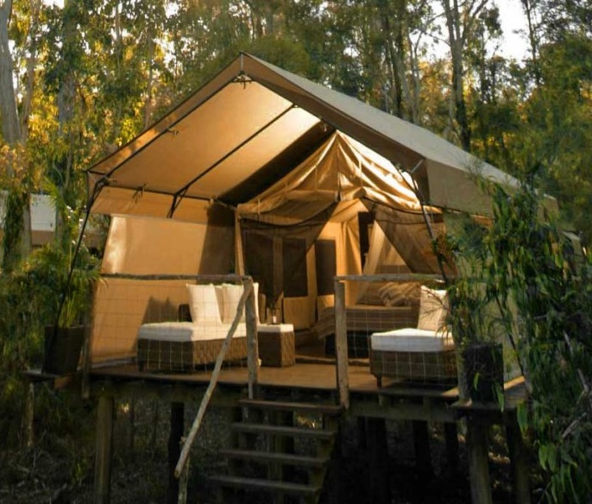
Research the factors that may be impacted by the proposed activity
Impacts can be positive or negative
Often lack of clarity/consensus about projected impacts will be
Tourism Operators who subscribe to industry Code are commonly required to research impact on these factors
There is often a mandatory external requirement for research of this type to be undertaken
Notes:
Trainer continues giving context for this noting:
Impacts can be positive or negative – a positive impact in one area/set of factors can also result in a negative impact in one or more other areas/sets of factors: the impact is not always unilaterally positive or negative for any given initiative
There is often a lack of clarity and/or consensus about what the projected impacts of a minimal impact tourism initiative will be – despite consultation, debate and discussion there can be quite heated disagreement about the way research was done, assumptions which were made, stakeholders who were involved and the amount and type of consultation entered into
Tourism Operators who subscribe to an industry Code relating to sustainable/minimal impact tourism development/operation are commonly required by that Code to research impact on these factors – as standard practice
There is often a mandatory external requirement for research of this type to be undertaken – before a proposal can be approved by local communities, government agencies or industry bodies (and/or for funding).
Classroom Activity – Guest Speaker
Trainer arranges for Officer/representative from local government tourism agency to attend and:
Detail their orientation to sustainable tourism
Explain support available to industry for sustainable tourism initiatives
Describe compliance requirements for local tourism initiatives.

Slide 18
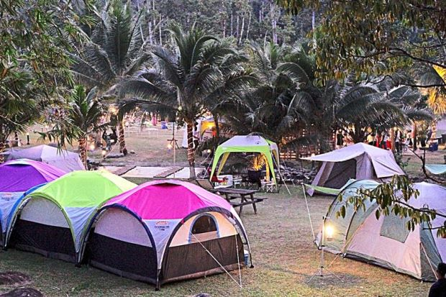
Research the factors that may be impacted by the proposed activity
It is generally understood tourism initiatives have the potential to have impacts on:
The environment
Society and culture
The economy
Notes:
Trainer indicates it is accepted tourism generally impacts:
The environment
Society and culture
The economy.
Classroom Activity – Internet Research
Trainer facilitates research and discussion of:
http://www.unep.org/resourceefficiency/Business/SectoralActivities/Tourism/FactsandFiguresaboutTourism/ImpactsofTourism/tabid/78774/Default.aspx - Impacts of tourism

Slide 19

Research the factors that may be impacted by the proposed activity
There is also a need to look at ‘carrying capacity’ with reference to:
Ecological carrying capacity
Social carrying capacity
Psychological carrying capacity
Economic carrying capacity
Notes:
Trainer also mentions there is a need to consider the carrying capacity of the location, with reference to:
Ecological carrying capacity relates to the maximum use of a tourist resource without causing any harm to the environment
Social carrying capacity relates to the reaction of the local people to the tourist development of the place, which should never be negative
Psychological carrying capacity relates to the quality of visitors’ satisfaction with a certain tourist destination, which is not to be decreased
Economic carrying capacity relates to the level of acceptable dependence between the local economy and the level of the tourist development of a place, which should never become too heavy.
Classroom Activity – Internet Research
Trainer facilitates research and discussion of:
http://www.slideshare.net/tofujay/carrying-capacity-16284835 - Carrying capacity
http://www.biodiversity.ru/coastlearn/tourism-eng/con_capacity.html - Sustainable Tourism
http://www.google.com/url?sa=t&rct=j&q=&esrc=s&source=web&cd=3&ved=0CDcQFjAC&url=http%3A%2F%2Fwww.danubecc.org%2Fupl%2FE-learning%2520Modules%2FModule%25205%2520-%2520Tourism%2520carrying%2520capacity.doc&ei=fHVrVbLyLZD98QWf-4OgAw&usg=AFQjCNHcxtceGSLuL43c7uLhc3MsiCptOQ&sig2=XNjpn4KWDS3PsUfn10Eobw&bvm=bv.94455598,d.dGc – Module 5:Tourism carrying capacity

Slide 20

Research the factors that may be impacted by the proposed activity
Possible environmental factors impacted by a tourism initiative can be related to:
The natural environment
The built environment
The ecology
Notes:
Trainer explains possible environmental factors impacted by a tourism initiative can be related to:
The natural environment – which may include:
Possible air pollution – caused by vehicles and camp fires
Contamination of fresh water, sea water and drinking water – through litter and sewage
Degradation of land/landscape – as a result of vehicles, presence of tourists, tourism activities on-site, camping
Increased use of scarce local resources – such as fuel, drinking water,
Greater levels of noise – caused by the extra vehicles, activities and people
Aesthetic pollution – simply caused by presence of vehicles, people and man-made items in a natural environment
Increase in waste (litter and rubbish) generated by tourists and their presence/activities
The built environment – in relation to the impact of extra people/tourists in relation to:
How their presence will affect the existing infrastructure – such as impact of tourists coaches and vehicles on local roads; impact of extra people at monument sites and buildings (museums, public toilets, hospitals, transport hubs)
Need to build/provide new infrastructure/buildings – to cater for proposed traffic (vehicular and pedestrian/foot)
The ecology – and the impact of tourism on:
Animals and their habitat; Plants; Other organisms.
Classroom Activity – Internet Research
Trainer facilitates research and discussion of:
http://www.unep.org/resourceefficiency/Home/Business/SectoralActivities/Tourism/WhyTourism/ImpactsofTourism/EnvironmentalImpacts/tabid/78775/Default.aspx – Environmental impacts.

Slide 21

Research the factors that may be impacted by the proposed activity
Possible socio-cultural factors impacted by a tourism initiative can be related to:
Commodification of a community/society
Standardisation
Loss of authenticity
Adaptation to tourist demands
(Continued)
Notes:
Trainer explains possible socio-cultural factors impacted by a tourism initiative can be related to:
Commodification of a community/society – where their rituals and culture are converted into a ‘product’ to be sold, creating what they call a ‘reconstructed ethnicity’ which is altered for commercial purposes
Standardisation – meaning the unique nature of a culture/society is standardised to meet the expectations of (some) tourists
Loss of authenticity – as the people adapt to accommodate the actual or perceived needs of the tourists, producing sometimes what the UN refers to as ‘staged authenticity’
Adaptation to tourist demands – as local communities focus of producing artefacts and items suited to the demands of tourists rather than their own needs.
Classroom Activity – Internet Research
Trainer facilitates research and discussion of:
http://www.unep.org/resourceefficiency/Home/Business/SectoralActivities/Tourism/WhyTourism/ImpactsofTourism/SocioCulturalImpacts/tabid/78780/Default.aspx – Socio-cultural impacts.

Slide 22

Research the factors that may be impacted by the proposed activity
Cultural clashes
Increase in crime rates
Child labour
Prostitution and sex tourism
Notes:
Trainer continues to explain possible socio-cultural factors impacted by a tourism initiative can be related to:
Cultural clashes – where people from different cultures do not mix, perhaps based on:
Economic inequality between cultures/peoples
Irritation regarding the behaviour displayed by tourists while at the location
Job level friction – in that local people are often employed in lower level/lower paying jobs than other workers employed by the Tourism Operator
Increase in crime rates – caused when locals steal from tourists
Child labour
Prostitution and sex tourism.
Classroom Activity – Internet Research
Trainer facilitates research and discussion of:
http://www.unep.org/resourceefficiency/Business/SectoralActivities/Tourism/FactsandFiguresaboutTourism/ImpactsofTourism/Socio-CulturalImpacts/NegativeSocio-CulturalImpactsFromTourism/tabid/78781/Default.aspx – Negative socio-cultural impacts from tourism.

Slide 23

Research the factors that may be impacted by the proposed activity
Possible economic factors impacted by a tourism initiative can be related to:
Employment
Investment
Inflation
(Continued)
Notes:
Trainer explains possible economic factors impacted by a tourism initiative can be related to:
Employment – and:
The number of jobs created – and the status of these jobs as measured by indicators (such as) number of hours per week, number of full-time jobs, number of part-time jobs, number of casual jobs or hours
The level of these jobs – in terms of whether they are permanently low-level positions or whether they allow for genuine career development
Conditions of employment provided by employers for the workers
Investment – in terms of issues such as:
Infrastructure
Buildings
Training and development
Repairing damage to the environment
Inflation – and how this affects:
Price of land and houses for locals – when Tourism operators purchase land and buildings: there may be a need to protect the interests of locals by limiting the amount, location or type of purchases which can be made by Tourism organisations
Cost of limited resources/raw materials – as these are bought for tourism purposes, they commonly become more expensive for locals so there may be a need to limit what can be purchased or to require Tourism Operators to carry in all the resources they want to use

Slide 24

Research the factors that may be impacted by the proposed activity
Local income
Opportunity cost
Extent of reliance on tourism
Notes:
Trainer continues to explain possible economic factors impacted by a tourism initiative can be related to:
Local income – and how this:
Enables tangible benefits for the recipients – as defined by the relevant community (which may be in terms of housing acquisition; standard of living indicators; access to food, medical, education and/or other services)
Circulates throughout the local economy – known as the ‘multiplier effect’, economists believe money earned by one person in a community can circulate throughout the economy up to four times (as people spend that money within their community) bringing an economic benefit for four people not just the original one person
Opportunity cost – meaning the money spent on tourism cannot be spent on something else which may have brought a larger benefit to the area/people
The extent of reliance on tourism-related income and contribution made by tourism to regional development – in general:
Total dependence on tourism is seen as a bad thing – subject to seasonal influences, global trends, and rapid changes caused by external events
Partial reliance on tourism is regarded as a positive element of a wider economic plan.
Classroom Activity – Internet Research
Trainer facilitates research and discussion of:
http://www.unep.org/10yfp/Portals/50150/downloads/Asia_Pacific_10YFP_Roadmap_2014_2015_FINAL.pdf - The 10 Year Framework of Programmes on Sustainable Consumption and Production (10YFP): Roadmap for the 10YFP implementation in Asia and the Pacific 2014 –­ 2015 with particular attention to Section C.1.D ‘Sustainable tourism including eco-tourism’
http://www.eucentre.sg/wp-content/uploads/2013/12/EUCResearchBrief_TourismEU27ASEAN.pdf - Tourism as a driver of economic growth and development in the EU-27 and ASEAN regions

Slide 25

Research the factors that may be impacted by the proposed activity
Leakage
Enclave tourism
Infrastructure costs
Notes:
Trainer continues to explain possible economic factors impacted by a tourism initiative can be related to:
Leakage – which refers to the amount of money lost to a local community after all expenses to governments (taxes, levies, fees, charges) are paid, and after all payments to external organisations (the businesses who own the tour companies, hotels, transport companies, catering outlets) are made
Enclave tourism – where tourists visit an area but spend most of their money in the one location (a hotel, cruise ship, resort) rather than spreading it around among local community people or smaller local businesses
Infrastructure costs – where local governments are forced to pay the cost of building roads and providing support services (police, medical, tax relief for tourists) to enable tourism to function.
Classroom Activity – Internet Research
Trainer facilitates research and discussion of:
http://www.unep.org/resourceefficiency/Business/SectoralActivities/Tourism/FactsandFiguresaboutTourism/ImpactsofTourism/EconomicImpactsofTourism/NegativeEconomicImpactsofTourism/tabid/78784/Default.aspx - Negative economic impacts of tourism
http://www.slideshare.net/reymarieoohlala/overview-of-tourism-impacts - Overview of tourism impacts.

Slide 26

Research the factors that may be impacted by the proposed activity
Ways to research factors:
Talk to those who have conducted similar programs
Read reports on initiatives which have already been conducted
Speak with local communities
Communicate with those expected to be impacted
Establish baseline data/benchmarks
Visit the area
Notes:
Trainer presents strategies for researching the factors likely to be impacted by a tourism initiative noting a blend of options is the most effective approach to use:
Talk to those who have conducted similar operations in similar areas – to obtain their input
Read reports on previous similar activities – many of these exist to provide data on other tourism initiatives
Speak with local communities who have been the subject of previous activities
Communicate with those expected to be impacted by the proposed activity
Establish baseline data/benchmarks – to use as reference points for future monitoring and evaluation
Visit the area – to gain first-hand experience of the location and meet face-to-face with the community and those who will/may be impacted.
Classroom Activity – Internet Research
Trainer facilitates research and discussion of:
http://crctourism.com.au/wms/upload/resources/bookshop/3-3_socialimpacts_v01_web.pdf – Social impact of tourism on the Gold Coast
http://ijbssnet.com/journals/Vol_4_No_3_March_2013/2.pdf – Understanding the economic impact of tourism in the Asia Pacific region using the Tourism Satellite Account
http://cdn.intechopen.com/pdfs-wm/35710.pdf – A model for assessing the level of tourism impacts and sustainability of coastal cities.

Slide 27

Research compliance requirements that apply to proposed activity/operation and location
Sources of information on compliance requirements may be:
Legislation
By-laws
Voluntary Codes of Practice/Conduct
Mandatory Codes
Local agreements with communities
Notes:
Trainer identifies possible sources of compliance requirements:
Legislation – these are the laws (the Acts) which need to be complied with
There may be a need to comply with the laws of individual countries in which tourism activities are being conducted and/or relevant aspects of laws which may emerge on the establishment of the ASEAN Community (AC)
By-laws – these are mandatory rules and regulations imposed by various ‘bodies’ such as:
Government agencies; Local Councils; Local communities
Voluntary Codes of Practice – which may be:
Generated by an industry body – in consultation with membership to set industry-wide standards for its members
Imposed by a government agency – who develop them to support attainment of strategic plans they have made
Developed by individual Tourism Operators – as a public statement they make about themselves to customers to advertise and demonstrate their orientation and practices in regard to responsible tourism. Operators may seek to create an individual COP that provides a ‘point of difference’ for them when compared with their competitors
Mandatory Codes of Practice – which are written by government agencies and are legally-binding requirements
These COPs are created under the authority of nominated pieces of legislation and are written to show organisations how they can/must operate in order to fulfil their legal obligations. In effect. If the business follows the COP, they are complying with the law
Agreements which are already in place with local communities – as they have been negotiated with other Tourism Operators for previous tourism activities
Arrangements already agreed to by the Tourism Operator – which may be imposed by virtue of:
Formal, written contracts with suppliers and/or clients
Verbal agreements and ‘promises made’ with partners, businesses and stakeholders.
Classroom Activity – Handouts
Trainer distributes and discusses sample legislation, COPs and other documentation as identified on the slide.

Slide 28

Research compliance requirements that apply to proposed activity/operation and location
Compliance requirements may be seen as:
Drives for change
Obstacles to development
Notes:
Trainer stresses there is always a need to read documentation relevant to individual proposals to gain a proper understanding of what is necessary emphasising in practical terms, compliance requirements may be:
Drivers for action – in that laws may provide tax concessions for investment in tourism initiatives
Obstacles to development – by limiting (or prescribing) what can be done, where it can be done, when it can be done and how it can be done.

Slide 29

Research compliance requirements that apply to proposed activity/operation and location
Legislated compliance obligations may relate to:
Employment
Building and construction
Incorporation and registration of businesses
(Continued)
Notes:
Trainer indicates requirements which can be imposed by Acts, regulations established under those Acts and mandatory COPs may relate to:
Employment – with possible reference to selection and hiring of staff as well as employment contracts and conditions of employment
Building and construction – including zoning
Incorporation and registration of organisations and operating entities
Classroom Activity – Guest Speaker
Trainer arranges for local Council representative/official to attend and:
Discuss local compliance requirements for Tour Operators seeking to initiate a new tourism activity
Talk about local support for tourism initiatives
Describe local tourism activities they have been involved with and how they have supported them.

Slide 30

Research compliance requirements that apply to proposed activity/operation and location
Safety, health and welfare issues
Taxation
Operational matters
Notes:
Trainer continues to talk about possible legislated obligations:
Safety, health and welfare – as it applies to workers, customers/tourists and members of the public
Taxation – and registration as a business and payment of applicable rates of tax which can include import taxes, company tax, bed tax, consumption tax, service tax and others
Operational matters – such as laws governing:
Sale/use of alcohol
Food preparation, service and storage, vehicle registration
Vehicles – in terms of vehicle registration, licensing of drivers and obeying road rules.

Slide 31

Research compliance requirements that apply to proposed activity/operation and location
Voluntary industry COPs may impose obligations to:
Comply with all applicable laws
Respect local community, people and the environment
Leave the area as it was found
(Continued)
Notes:
Trainer explains voluntary Codes developed by industry bodies and/or individual operators are likely to contain requirements about:
Complying with all applicable laws
Respecting the local community, people and the environment
Leaving an area, when on tour, in the same condition as when it was entered – referring to the need to ‘carry everything in and carry everything out’ (which may include carrying out not only all litter/rubbish but also human waste

Slide 32
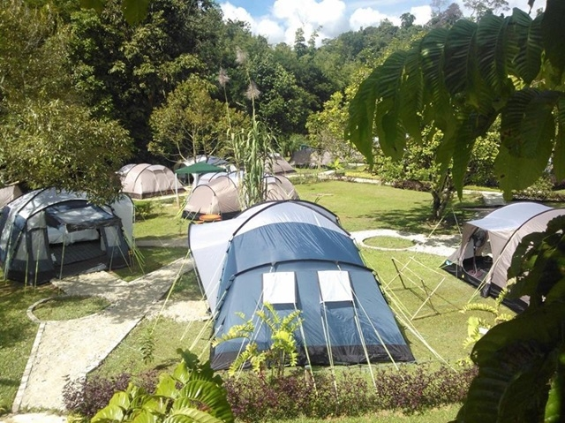
Research compliance requirements that apply to proposed activity/operation and location
Do no harm
Act in an ethical and responsible manner
Provide a genuine tourism experience
Notes:
Trainer continues to talk about possible voluntary COP obligations:
Doing no harm – to people (regarding bullying, harassment, discrimination) or physical or natural resources
Acting in an ethical and responsible manner with care, professionalism and diligence – based on sound knowledge and training
Providing a genuine tourism experience – supported by identified or relevant information, staff, information, food, accommodation, transport and activities.
Classroom Activity (1) – Internet Research
Trainer facilitates research and discussion of:
http://www.gdrc.org/uem/eco-tour/apec_pata-code.html - The APEC/PATA Code for Sustainable Tourism.
Classroom Activity (2) – Group Discussion
Trainer leads class in discussion of practical examples of what constitutes “an ethical and responsible manner with care, professionalism and diligence”.

Slide 33
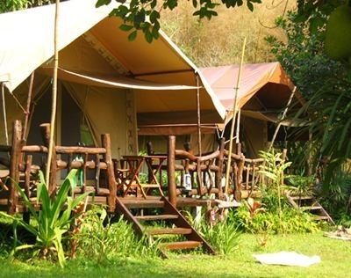
Develop a plan that details experience and activities to be implemented
Sustainable tourism initiatives must be planned and the plan must be:
In writing
The result of adequate consideration and consultation
Realistic and achievable
Notes:
Trainer reiterates need for sustainable tourism initiatives to be planned highlighting the plan must be:
In writing – so there is surety about it and the plan can be easily shared with others
The result of adequate consideration and consultation – with identified stakeholders
Realistic and achievable – within the context of the business environment for the proposer.

Slide 34

Develop a plan that details experience and activities to be implemented
Plan should contain:
Explanation of how proposal meets identified local needs
Description of the extent and type of activities and operations proposed
Identification of timing details
Provision of evidence proving required approvals and permissions have been approved/granted
(Continued)
Notes:
Trainer presents standard requirements of this type of plan include:
Explanation of how the proposal meets identified local needs – while at the same time addressing identified concerns by including action to minimise negative effects and maximise positive impacts
Description of the extent and type of activities and operations proposed – including specification of the site/location to be used and the nature of the activities/operations to be conducted
Identification of timing details – including development time, commencement dates, duration of the activity/operation and specification of daily hours of operation
Provision of evidence proving required approvals, permissions, authorities, licenses and registrations have been approved/granted – by local communities and authorities

Slide 35

Develop a plan that details experience and activities to be implemented
Development of behaviour stipulations for tour group members
Identification of process for trialling the initiative
Explanation of how objectors can register objections
Consultation that will occur with relevant communities and individuals
Description of monitoring protocols
Notes:
Trainer continues to present standard requirements of the plan:
Development of behaviour stipulations for tour group members – when they visit the site, participate in activities and/or engage with local people and communities
Identification of the process that will be followed for trialling the initiative – prior to full implementation of the proposal
Explanation of how objectors can register their objection to the proposal – together with explanation of the process that will be followed when an objection is received
Consultation that will occur with relevant communities and individuals – prior to final implementation decision being made
Description of monitoring protocols – to assess impact of proposal on local environment and communities.
Classroom Activity – Internet Research
Trainer facilitates research and discussion of:
http://www.environment.gov.au/system/files/resources/9c8f5084-3565-4f26-8801-77da3458f497/files/steps.pdf - Steps to Sustainable Tourism: planning for a sustainable future for tourism, heritage and the environment.
Attention must be paid to:
The 10 Steps: pages 7 – 55
Ways to use the document: page 11
Those who might use the document: page 12
Four guiding principles: pages 13 – 14
Step 9 - How to do it: pages 51 – 53
Summary checklist: pages 56 – 57.

Slide 36

Develop a plan that details experience and activities to be implemented
Details and content of the plan will vary between initiatives
As an example, a plan to introduce a new overnight tour to an area may contain:
Date/s of trial
Time/s group will arrive
Tour duration
Number of people in each group
(Continued)
Notes:
Trainer explains the details of the trial (or ‘pilot’) to be contained in the plan and the nature of the content will vary between the type of activities being planned stating for example, the plan for the trial of an initiative to conduct an overnight tour into a new location may require specification of:
Date/s of the trial tours
Time/s the tour group/s will arrive
Duration of tour/s on each date
Number of people in each tour group

Slide 37
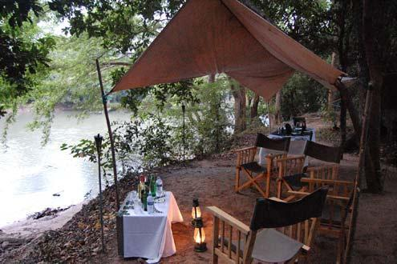
Develop a plan that details experience and activities to be implemented
Group profile
Itinerary
Route/s to be used – vehicle and foot traffic
Location and size of camp
(Continued)
Notes:
Trainer continues identifying sample contents of pilot/trial plan:
Group profile – by relevant demographic characteristics (where appropriate for the type of activity/tour being offered – for example the Tourism Operator may be seeking to target children for school camps/excursions, or seeking to target senior citizens)
Itinerary for each tour
Route/s to be used – in relation to:
Entry to the site/area and exit from it
Travel within the area
Foot traffic and vehicles
Location and size of camp site

Slide 38
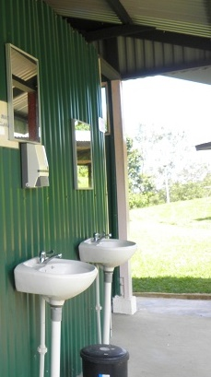
Develop a plan that details experience and activities to be implemented
Facilities in camp
Interpretive activities
Estimated use of local resources and facilities
Resources to be ‘carried in’
Details of ‘prohibited items’
(Continued)
Notes:
Trainer continues identifying sample contents of pilot/trial plan:
Facilities within the camp
Interpretive activities to be conducted
Estimated use of local resources and facilities – which might reference things such as water, wood, fuel, shops, toilet facilities, huts, cooking and dining areas and camp sites
Details of resources to be carried into the area by the Tourism Operator – and details of items which have been declared ‘prohibited items’

Slide 39

Develop a plan that details experience and activities to be implemented
Role/s of local communities/personnel
Arrangements regarding latrines and washing facilities
Details of waste management
Tour group ‘Code of Conduct’
Notes:
Trainer continues identifying sample contents of pilot/trial plan:
Role of local communities in the operation of the tour – such as voluntary commitment or paid work as:
Local area tour guides
Participants in certain interpretive activities
Labour for unpacking tour vehicles, pitching tents, setting up camps and breaking camp and packing for departure
Food workers employed to prepare, cook and serve meals
Arrangements for latrines and washing facilities
Details of waste management – which may require ‘carrying out’ of waste
‘Code of Conduct’ for tourists and tour staff when in the area

Slide 40

Develop a plan that details experience and activities to be implemented
Emergency Management Plans
Monitoring activities to be applied
Process to be used to evaluate monitoring data
Notes:
Trainer continues identifying sample contents of pilot/trial plan:
‘Emergency Management Plans’ to address events identified by standard risk management (that is, risk identification, risk assessment/evaluation and risk control) for the area, the nature of the tour and the expected/known profile/s of the tour groups
Description of the monitoring activities to be conducted – and names of those with responsibility for undertaking them
Description of the process to be followed to analyse and evaluate the data captured during the monitoring phase.

Slide 41

Develop a plan that details experience and activities to be implemented
‘The ASEAN Tourism Standards’:
Agreed to by ASEAN National Tourism Organizations to help ASEAN be a Quality Single Destination
Involves a certification process
Should be integrated into sustainable tourism initiatives
Notes:
Trainer introduces ‘The ASEAN Tourism Standards’ highlighting they:
The ASEAN National Tourism Organizations have agreed on six ASEAN Tourism Standards to help ASEAN be a Quality Single Destination
This initiative uses a certification process to ensure tourism service providers adhere to require standards which will enable sustainable tourism and provide standardised products to visitors
Those preparing plans for pilot sustainable/ minimal impact tourism projects should integrate the matters identified by this initiative in their planning.

Slide 42

Develop a plan that details experience and activities to be implemented
The six standards are:
Green Hotel
Food and Beverage Services
Public Restroom
Home Stay
Ecotourism
Tourism Heritage
Shangri-La Hotel, Kuala Lumpur Receives The ASEAN Green Hotel Award For The Fourth Time Running (2014) …
Source: eGlobal Travel Media (wwweglobaltravelmedia.com.au)
Notes:
Trainer identifies ‘The ASEAN Tourism Standards’ are:
Green Hotel
Food and Beverage Services
Public Restroom
Home Stay
Ecotourism
Tourism Heritage

Slide 43

Develop a plan that details experience and activities to be implemented
Green Hotel:
Is a hotel which is environmentally-friendly and adopts energy conservation measures
Food and Beverage Services:
Local F&B Service is a form of service where traditional and typical food and beverages are produced and/or sold by local people in food stalls, local restaurants or other similar outlets
Notes:
Trainer provides overview of the Standards:
1. Green Hotel
Green Hotel is a hotel which is environmentally-friendly and adopts energy conservation measures.
2. Food & Beverage Services
Local Food and Beverage Service is a form of service where traditional and typical food and beverages are produced and / or sold by local people in food stalls, local restaurants or other similar outlets.

Slide 44
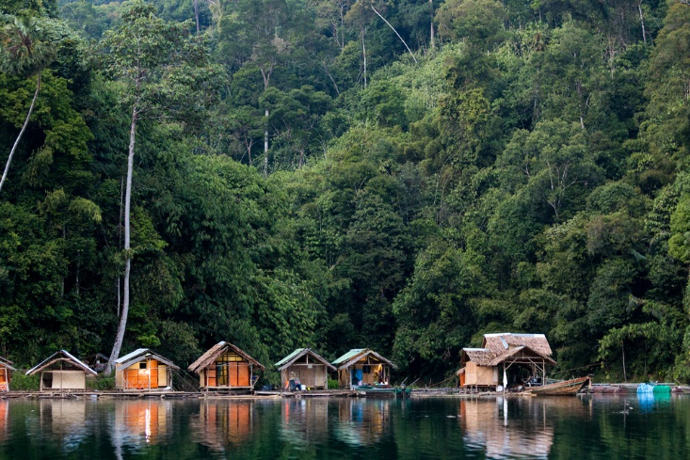
Develop a plan that details experience and activities to be implemented
Public Restroom:
Is a room or booth shared by all people for urination and defecation consisting of at least a bowl fitted with or without a seat and connected to a waste pipe and a flushing apparatus
Home Stay:
Is an alternative form of family furnished accommodation generally located in a house, providing guests opportunities to experience family/community lifestyle as well as tourist attractions
Notes:
Trainer provides overview of the Standards:
3. Public Restroom
Public Restroom is a room or booth shared by all people for urination and defecation consisting of at least a bowl fitted with or without a seat and connected to a waste pipe and a flushing apparatus.
4. Home Stay
Home Stay is an alternative form of family furnished accommodation generally located in a house, providing guests opportunities to experience family/community lifestyle as well as tourist attractions.

Slide 45

Develop a plan that details experience and activities to be implemented
Ecotourism:
Is responsible travel to destinations with ecological diversity that involves in activities, environmental and cultural conservation measures, and community participation providing benefits for the local people and the country
Notes:
Trainer provides overview of the Standards:
5. Ecotourism
Ecotourism is responsible travel to destinations with ecological diversity that involves in activities, environmental and cultural conservation measures, and community participation providing benefits for the local people and the country.

Slide 46

Develop a plan that details experience and activities to be implemented
Tourism Heritage:
Is an outstanding cultural or heritage area of a country that is protected, conserved and managed in a sustainable manner provided with easy access and support facilities for the enjoyment of visiting tourists
Notes:
Trainer provides overview of the Standards:
6. Tourism Heritage
Tourism Heritage is an outstanding cultural or heritage area of a country that is protected, conserved and managed in a sustainable manner provided with easy access and support facilities for the enjoyment of visiting tourists
Cultural Heritage refers to outstanding monuments and groups of buildings in a country that have authentic, historical, archaeological, scientific, anthropological and ethnic value
Natural Heritage refers to outstanding physical, biological and geological formations including its habitat and species that may be threatened and endangered.
Classroom Activity – Internet Research
Trainer facilitates research and discussion of:
www.aseantourism.travel/downloaddoc/doc/2488 – ASEAN Tourism Standards.
Special attention must be paid to:
Major Criteria and Requirements for the six standards: pages 6 – 17.

Slide 47

Summary – Element 1
When planning minimal impact operations:
Seek to create a sustainable tourism outcome
Operate in an open, honest and transparent manner
Undertake all planning using a consultative and collaborative approach
Ensure there is certainty about the proposal
(Continued)
Notes:
Trainer provides a recap of the Element asking questions to check trainee understanding and responding to questions from trainees, as required.

Slide 48

Summary – Element 1
Identify the specific geographic location where the operation will occur
Identify and actively include relevant stakeholders
Determine environmental factors which may be impacted
(Continued)
Notes:
Trainer provides a recap of the Element asking questions to check trainee understanding and responding to questions from trainees, as required.

Slide 49

Summary – Element 1
Identify societal and cultural factors which may be impacted
Specify ecological factors which may be impacted
Describe economic factors which may be impacted
(Continued)
Notes:
Trainer provides a recap of the Element asking questions to check trainee understanding and responding to questions from trainees, as required.

Slide 50

Summary – Element 1
Research all factors which have been assessed as being impacted
Become aware of all applicable mandatory and voluntary compliance requirements attaching to implementation of the initiative
Prepare a detailed written plan to guide a pilot/trial of the proposal
Obtain approval for the plan from stakeholders
Notes:
Trainer provides a recap of the Element asking questions to check trainee understanding and responding to questions from trainees, as required.

Slide 51

Element 2 – Trial minimal impact operations
Performance Criteria for this Element are:
Organise for the trial to be conducted
Conduct the trial operation as planned
Monitor the impacts of the trial
Evaluate the information generated by the trial
Utilise the information from the trial to modify previous plans so as to minimise negative effects and maximise positive impacts
Notes:
Trainer identifies for trainees the Performance Criteria for this Element, as listed on the slide.
Class Activity – General Discussion
Trainer leads a general class discussion by asking questions such as:
What is involved in these trials?
Why are they important/necessary?
Who is involved?
What monitoring activities might be conducted?
What factors might be monitored?

Slide 52

Organise for the trial to be conducted
The first step is to ‘Confirm the trial plans’ – which may:
Require presentation and explanation of final trial plans
Involve explanation of details
Necessitate responses to questions and concerns
(Continued)
Notes:
Trainer highlights confirming the plans/details for the trial/pilot of an activity may:
Require presentation and explanation of final trial plans – in a face-to-face meeting with stakeholders/local communities
Involve explanation of details
Necessitate responses to questions and concerns

Slide 53

Organise for the trial to be conducted
Verify checks and monitoring activities which have been provided as an integral element of the trial
Demand readiness to make last-minute changes which may be required by key stakeholders
Result in re-formulating draft trial plans
Notes:
Trainer continues discussing confirming trial/pilot plans
Verify checks and monitoring activities which have been provided as an integral element of the trial
Demand readiness to make last-minute changes which may be required by key stakeholders – or to address valid issues which have been overlooked
Result in re-formulating draft trial plans.

Slide 54

Organise for the trial to be conducted
Communication with stakeholders at this stage is vital and require:
Sharing hard copy plans
Verifying approval/s
Encouraging and/or obtaining cooperation
Negotiating final details
Maintaining positive relationships which have been established
Notes:
Trainer emphasises the need for communicating with stakeholders cannot be over-stated and at this stage of the process communication can require:
Sharing hard copy plans with them – which may mean:
Distributing hard and/or soft copies prior to meetings – so attendees can read them and think about them prior to meetings
Providing handouts at meetings – to those who have not already received them
Screening PowerPoint versions of the plan at group meetings
Verbally explaining the plan
Verifying approval/s – which have previously been promised, or provisionally given
Encouraging and/or obtaining cooperation – with the trial process
Negotiating final details – as/if required and/or negotiating ‘agreed amendments’ to the trial
Maintaining positive relationships which have been established.

Slide 55

Organise for the trial to be conducted
Communication may feature:
Community meetings
Face-to-face discussions
Telephone contact
Distribution of hard copy materials
Notes:
Trainer advises communication may feature:
Community meetings – on-site and/or with local communities at a place of their choosing
Face-to-face discussions with key individuals
Telephone contact
Distribution of hard copy plans – supported by verbal explanations and other explanatory documentation, as required (such as copies of legislation, COPs, reports).
Classroom Activity – Guest Speaker
Trainer arranges for representative of a local community to attend and:
Identify their concerns regarding tourism initiatives
Discuss their involvement with previous initiatives
Explain their requirements/preferences for communication with proponents.

Slide 56

Organise for the trial to be conducted
Regarding ‘establishment of required infrastructure; it is important to note:
This is not required for all initiatives
Tourism Operators are reluctant to pay significant sums of money for trials
Support from government agencies = likelihood they will contribute ‘seeding’ funding
Notes:
Trainer discusses establishment of required infrastructure noting:
This is not required for all initiatives – as it is possible the necessary infrastructure may already exist
Tourism Operators are reluctant to pay significant sums of money for trials – because there is no guarantee the trial will translate into an ongoing activity/operation
Where there is support from government agencies there is a likelihood they will contribute some ‘seeding’ funding to initiate the project and demonstrate their commitment to the project

Slide 57
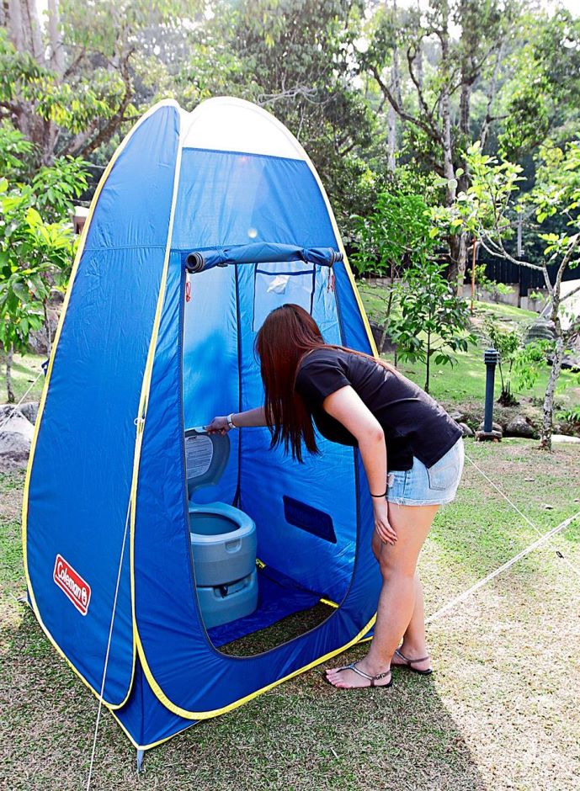
Organise for the trial to be conducted
Establishing infrastructure may involve:
Pegging out (or grading) of tracks to be used
Trucking in portable facilities
Making arrangements with local people, communities and/or businesses
Consideration of transport, social, environmental and collaborative infrastructure
Notes:
Trainer observes the definition of infrastructure in the context of a trial takes on a slightly different and ‘reduced’ meaning – in that it often refers to the building of smaller buildings than normal and the creation of temporary facilities rather than permanent ones highlighting it might involve:
Pegging out (or grading) of tracks to be used – as opposed to the actual building of roads or boardwalks
Trucking in portable facilities – rather than building them on-site
Making arrangements with local people, communities and/or businesses to supply the identified needs for the initiative – as distinct to creating/establishing them from scratch, or transporting all goods into the area
Consideration of transport, social, environmental and collaborative infrastructure.
Classroom Activity – Internet Research
Trainer facilitates research and discussion of:
http://www.infrastructureaustralia.gov.au/policy-publications/submissions/published/files/259_tourismandtransportforum_SUB.pdf – with attention to page 1
http://www.asean.org/communities/asean-economic-community/item/plan-of-action-on-asean-cooperation-in-tourism – with attention to Strategy 5.

Slide 58

Organise for the trial to be conducted
‘Monitoring requirements’ to be organised may/will be:
Contained in the plan for the trial
Imposed by government agencies
Insisted on by local communities
Suggested by consultants
Responsive to identified concerns
Based on other effective trials/pilots
Notes:
Trainer notes the monitoring resources for the trial will have been identified in the plan for the trial and requirements traditionally are:
Presented by the proponent as the strategies to use
Compulsorily required by government agencies
Insisted on by local communities
Suggested by paid/third party consultants
Responsive to particular identified concerns for the area and/or the type of initiative being trialled – these concerns may be (for example) about the impact on local people, the effect on the environment, and/or the use of local resources
Based on effective techniques used in other similar trials.
Examples of monitoring equipment and systems can range from basic resources to high-technology equipment – see later slides for data/information gathering options.

Slide 59
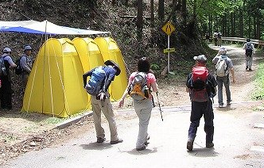
Organise for the trial to be conducted
‘Evaluation criteria and parameters’ will:
Be set for the trial before it starts as part of the plan – in consultation with stakeholders
Address interests of concern relevant to the initiative
Describe what will determine whether or not the trial is ‘acceptable’ or not
Notes:
Trainer explains most trials will set criteria by which the trial will be evaluated and some will not.
Standard practice is to pre-determine how the trial will be assessed before the trial commences with reference to:
Topics of interest or concern (‘criteria’) for local communities or other stakeholders – such as (for example):
Quality of local water or a designated water source
Noise levels generated by tour groups
Crimes reported as a consequence of the initiative
Money spent in local community by tour groups
Satisfaction of tour group members with the experience (activity/project)
Parameters for determining whether or not the trial was ‘acceptable’ (and could therefore go ahead) or ‘not acceptable’ (and would need to be abandoned or amended and re-trialled), such as:
‘Up to 10% use of drinking water is acceptable’
‘Decrease of over 5% of XYZ flora or fauna is unacceptable’
’10 complaints from the local community’
‘Minimum 75% satisfaction rating from tour group members’.

Slide 60
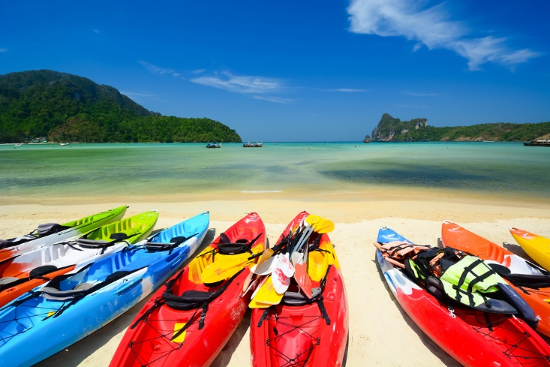
Organise for the trial to be conducted
Organisation also requires public commitment to transparency in relation to:
Conducting the trial
Observing the monitoring process
Allowing and facilitating stakeholder participation
Releasing truthful, comprehensive and accurate findings
Notes:
Trainer indicates organisation of the trial also requires the trial process is characterised by openness and honesty so a vital element of organising the trial is to publicly commit to transparency in relation to:
Conducting the trial – and enabling stakeholders and relevant others to watch what occurs
Observing the monitoring process – and how and when data is gathered
Allowing and facilitating stakeholder participation in the monitoring process – to demonstrate inclusivity
Releasing truthful, comprehensive and accurate findings of the trial – based on actual evidence gathered
Facilitating stakeholder engagement with process – by providing venues and facilities for meetings to discuss the initiative and the evaluation.
The commitment to transparency should be made at the outset when first contact is made with stakeholders and other interested parties.

Slide 61

Organise for the trial to be conducted
Benchmarks will need to be developed to use when evaluating the trial and those chosen:
May be decided on by one or more of the stakeholders
Must be relevant to the individual proposal/initiative
Should be decided on in consultation with stakeholders
Must address identified issues and concerns
Will form the basis of deciding the evaluation criteria and determining their parameters
Notes:
Trainer stresses the establishment of initial baseline data against which comparisons will be made following the trial is a critical reference point for post-trial evaluations and an important part of the organisation process.
This baseline data provides details of the area (and topics of interest) at the start of the initiative before the trial commences and no trial can/should begin until these benchmarks have been identified and agreed to.
The benchmarks chosen:
May be decided on by one or more of the stakeholders
Must be relevant to the individual proposal/initiative
Should be decided on in consultation with stakeholders
Must address identified issues and concerns
Will form the basis of deciding the evaluation criteria and determining their parameters.

Slide 62
Conduct the trial operation as planned
Requirements when implementing trial:
Conduct the trial exactly as planned
The publicly stated details must be adhered to
Meet with those who have monitoring responsibilities
Record any variations that are necessary to the planned implementation
(Continued)
Notes:
Trainer states when implementing the trial for a proposed sustainable tourism activity or operation there is a need to:
Conduct the trial exactly as planned – so outcomes can be readily matched against planned actions as this is an essential pre-requisite for a viable evaluation of the trial
The publicly stated details of (say) a tour must be adhered to – in terms of things such as group numbers, vehicles used, duration, activities, arrival and departure dates
Meet with those who have monitoring responsibilities – to confirm:
They have been trained
They are ready and able to undertake their allocated duties
They have the necessary resources to compete their role/s
They understand what is expected of them
Record any variations that are necessary to the planned implementation – this acknowledges things rarely go exactly as planned and there is a need to adapt on-the-spot as the need to do so arises.

Slide 63

Conduct the trial operation as planned
Take action to ensure implementation of trial reflects future actual tourist activity after the trial
Monitoring data captured needs to be a real reflection of tourist impact/s
Seek permission from stakeholders to vary agreed plan, if required and if possible
Be prepared to delay implementation if there are significant unexpected or unforeseen issues
Be available
Notes:
Trainer continues to indicate requirements when implementing the trial for a proposed sustainable tourism activity or operation:
Take action to ensure implementation of the trial reflects future actual tourist activity after the trial – that is, nothing must be done to influence the behaviour, impact or presence of tourists or the group during the trial period
The monitoring data captured needs to be a real reflection of tourist impact/s so evaluation decisions are based on genuine information, not false or otherwise misleading information
Seek permission from stakeholders to vary the agreed plan in advance of making any changes to previously agreed protocols – if this is possible
Be prepared to delay implementation if there are significant unexpected or unforeseen issues arising – which common sense demands require input from, or the approval from, stakeholders
Be available – so:
Stakeholders can discuss important/urgent issues
Monitoring information can be received and acknowledged
Problems arising can be decided
Interest in the trial can be demonstrated.

Slide 64

Monitor the impacts of the trial
Standard protocols when implementing monitoring:
Train the people
Establish one contact point for the monitoring process
Verify required resources have been provided
(Continued)
Notes:
Trainer identifies standard industry protocols when implementing monitoring activities are:
Train the people who are to undertake monitoring activities – so they:
Know what to do in relation to their allocated role/topic
Are competent in what they need to do
Know how to gather sufficient, valid, reliable and objective quantitative and qualitative data
Establish one contact point for the monitoring process – so people involved in the monitoring activity have a single, known person to:
Contact if they have a question, concern or problem
Forward their data/information to
Verify required resources have been provided – which can include:
Double-checking individuals have received their log books, sighting forms and similar
Making sure equipment/technology to be used is in place, has been correctly calibrated and is operating as intended
Set dates for the return of information which has been captured – to give sufficient time for the data to be analysed and evaluated so required decisions can be made and necessary reports can be written

Slide 65

Monitor the impacts of the trial
Provide easy-to-use channels to facilitate the return of information
Oversee and manage the monitoring process
Make public the raw data as it is obtained
Notes:
Trainer continues to identify standard industry protocols when implementing monitoring activities:
Provide easy-to-use channels to facilitate the return of information – such as:
One telephone number; A website or email address; A postal address; People who will travel to the data collectors to collect the data from them
Oversee and manage the monitoring process – by, for example:
Being proactive in communicating with those who are monitoring the trial to determine if they have issues or need assistance; Ensuring identified monitoring practices are being undertaken as planned/promised; Following up with people when expected data is not submitted by the due time/date;
Arranging for extra or different personnel to perform monitoring activities as the need to do so emerges
Make public the raw data as it is obtained – to demonstrate the commitment to transparency, honesty and openness. This may be done by:
Posting data on a nominated website; Issuing press releases showing the information captured; Making public statements regarding the data gathered.
Classroom Activity – Guest Speaker
Trainer arranges for experienced Tourism Operator to attend and:
Discuss sustainable tourism initiatives they have trialled
Describe implementation practices for pilots
Give advise for planning, trialling and implementing minimal impact tourism initiatives.

Slide 66

Monitor the impacts of the trial
Data gathering options may include:
Completing hand-written/electronic documents:
Logs
Sighting forms
Notebooks
(Continued)
Notes:
Trainer advises data gathering for the purposes of monitoring the impacts of a sustainable tourism project may involve:
Completing hand-written (or computer/lap-top/tablet-based) documents such as:
Logs – these will record what happened and when it happened and will be used to record dates, times, numbers, times, statistics, observations, names of groups, points of interest or concern
Sighting forms – these can be targeted to record observations in relation to nominated topics which might relate to:
Movement or sighting of animals/wildlife
Identification of introduced threats, risks, dangers or hazards to the area
Observed actions/behaviour of tour groups
Observed impacts of the tourism initiative on local communities
Notebooks – which can be used to allow designated persons to record their generic observations, thoughts and feelings about the initiative as it unfolds.
Classroom Activity – Handouts
Trainer distributes and discusses the use of sample data gathering tools as identified on the slide.

Slide 67

Monitor the impacts of the trial
Obtaining photographic evidence
Using technology/scientific equipment
Gathering anecdotal evidence
Liaising with key stakeholders
Notes:
Trainer continues to present data gathering options:
Obtaining photographic evidence – may require distribution of still and movie cameras to allow:
Capture proof of ‘before and after’ scenarios and the actual operation of the trial (such as the conduct of interpretive activities; the camp site used; the way tour groups interact with the community and landscape)
Gather visual data to support, supplement and/or explain other observations as contained (for example) in logs, notebooks, personal observations and anecdotal evidence
Using technology and equipment to take basic measurements – such as:
Taking temperature/s; Noting weather conditions ; Calculating estimations of percentage cover of flora in an area
Determining fauna movement/s; Recording water flow; Measuring water volumes; Monitoring air quality
Counting customer traffic
Gathering anecdotal evidence – through being proactive and:
Talking to tour group members about their experience
Discussing initiative one-on-one or in a group setting with local communities and encouraging them to discuss their observations, feelings and concerns
Listening and noting what people (members of the public, stakeholders, those with monitoring responsibilities) say ‘by the way’ when they submit formal data or make contact for any reason in relation to the trial
Liaising with key stakeholders – which can include:
Asking tour leaders/project managers to compete feedback forms/reports
Holding meetings to facilitate exchanges and contributions
Recording details of what is said and who says them.

Slide 68

Evaluate the information generated by the trial
When evaluating information generated by trial:
Base decisions on facts and evidence
Reference evaluations to criteria and parameters established
Consider quantitative data and qualitative information
Align relevant data to identified topics
(Continued)
Notes:
Trainer explains when evaluating the information generated by the trial it is important to:
Base decisions on facts and evidence – all findings must be able to be supported by proof, and defended or be able to be validated if challenged
Reference evaluations to the criteria and parameters established for the trial – as these are the keys for determining the final outcome/s for the trial
Consider quantitative data and qualitative information – as both of these have a role (‘two sides of the same coin’) in the total evaluation of any trial, providing factual evidence as well as descriptive references
Align relevant data to identified topics – so there is a direct link between criteria established for the trial and the data which was captured

Slide 69

Evaluate the information generated by the trial
Analyse positive and negative impacts
Highlight any difficulties, problems or issues which occurred
Involve stakeholders in the process
Generate additional data if required
(Continued)
Notes:
Trainer continues to identify important points when evaluating trial data:
Analyse positive and negative impacts – in theory, every tourism trial holds the potential to generate positive and negative outcomes so the evaluation needs to be alert to identifying, describing and quantifying both potential results in order to achieve balanced and unbiased findings
Highlight any difficulties, problems or issues which occurred during the trial period – and which may have (or actually did) impact on the trial ad data which was collected
Involve the stakeholders in the process to demonstrate transparency – and to avoid conducting the evaluation behind closed doors and generating results and recommendations (‘findings’ of the trial) in private
Generate additional data if required – this may occur when:
Where insufficient data exists on which to base decisions
When the data is deemed not to be reliable or valid
An issue has arisen necessitating more or different data t be gathered
An error in data collection has been identified
Significant disagreement exists among stakeholders about the legitimacy of the data being relied on.

Slide 70

Evaluate the information generated by the trial
Explain methodology used to undertake the evaluation
Generate a set of clear and distinct findings as a result
Communicate outcomes of the trial
Notes:
Trainer continues to identify important points when evaluating trial data:
Explain the methodology used to undertake the evaluation – so those reading the findings can understand:
How the data was collected and analysed
How the decisions made as a result of the trial were arrived at
Generate a set of clear and distinct findings as a result of the evaluation – which will be presented as the basis for moving the sustainable tourism project forward
Communicate the outcomes of the trial – by sharing, publishing or otherwise widely communicating the findings.

Slide 71

Evaluate the information generated by the trial
Possible positive environmental impacts:
Opportunities for conservation and protection of buildings and facilities
Opportunities for conservation and protection of the natural environment
Education of visitors relating to local environmental issues
Potential to improve sites that have been de-graded prior to the initiative
Notes:
Trainer discusses possible positive environmental impacts:
Opportunities for conservation and protection of buildings and facilities – as a consequence of Tourism Operators wanting to preserve these things and/or enhance them for the benefit of tourists
Opportunities for conservation and protection of the natural environment – where the Tourism Operator is prepared to take action to protect the landscape against threats in order to preserve it for tour groups to experience and enjoy
Education of visitors relating to local environmental issues – meaning the message about local problems and challenges can be spread around the world and awareness of the problem/s might stimulate action to mitigate problems
Potential to improve sites that have been de-graded prior to the initiative – in that Tourism Operators are often prepared to pay for the repair and/or upkeep of buildings and the natural environment.

Slide 72

Evaluate the information generated by the trial
Possible negative environmental impacts:
Physical damage to building and facilities
Damage to the natural environment
Pollution
Presence of waste
Use of local limited energy resources
Adverse visual impacts on the site/area
Notes:
Trainer discusses possible negative environmental impacts:
Physical damage to building and facilities – caused by pedestrian traffic, vehicles, use/extra use (normal ‘wear and tear’) as well as accidental and deliberate damage
Damage to the natural environment – including soil/land erosion, compacting of soil, use of land for buildings, car parks, camp sites
Pollution – which may involve air (smoke) pollution, water pollution, noise pollution
Presence of waste – or additional litter/rubbish and human waste
Use of local limited energy resources (water and wood)
Adverse visual impacts on the site/area – as the initiative negatively affects the beauty of the area or interrupts or interferes with the ‘look and feel’ of the location.

Slide 73

Evaluate the information generated by the trial
Possible positive social impacts:
Improved facilities and infrastructure
Improved understanding regarding local issues
Improved relationships between the local community and other communities
More things for local communities to do
Notes:
Trainer discusses possible positive social environmental impacts:
Improved facilities and infrastructure – which can be used by local communities and/or which provide enhanced experiences (such as comfort and safety) for tourists
Improved understanding regarding local issues – so there is wider awareness, and appreciation of these problems which can lead to a better understanding of the communities and may trigger external assistance for problems
Improved relationships between the local community and other communities – based on the knowledge which flows when there is interaction between the two
More things for local communities to do – and increased opportunities for them to interact with others and expands their horizons to become more aware of other cultures, countries and communities.

Slide 74

Evaluate the information generated by the trial
Possible negative social impacts:
Social dislocation
Potential for increase in criminal activities
Reduced focus on (and potential interruptions to) traditional social interactions and activities between people in the local communities
Notes:
Trainer discusses possible negative social impacts:
Social dislocation – which disrupts the established pattern of communities and may cause changes to ‘regular’ things such as where people live, how they work and changes to traditional lifestyles and values
Potential for increase in criminal activities – caused commonly by tourists stealing from local communities, or by local communities stealing from tourists
The potential for assaults, prostitution and child sex may also be an issue
Reduced focus on (and potential interruptions to) traditional social interactions and activities between people in the local communities – caused by:
The physical presence of tourists
Competing pressures on time
Stress caused by the need to accommodate tourist-related needs/demands.

Slide 75

Evaluate the information generated by the trial
Possible positive ecological impacts:
Increased awareness of ecological issues
Potential for investment in the area
Notes:
Trainer discusses possible positive ecological environmental impacts:
Increased awareness of ecological issues – these will vary between locations but it is generally accepted raising awareness of ecological problems that exist in an area is a good thing in that it:
Can encourage action to stop or reduce activity that is causing the problem
Attract external assistance to mitigate the rate of degradation which is occurring
Potential for investment in the area – to:
Create additional habitat to encourage the growth and development in numbers and species of flora and fauna
Rehabilitate damaged land
Protect existing areas from damage

Slide 76
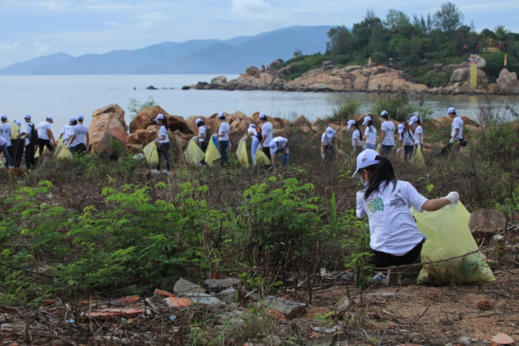
Evaluate the information generated by the trial
Possible negative ecological impacts:
Damage to flora
Disturbance to fauna
Notes:
Trainer discusses possible negative ecological environmental impacts:
Damage to flora – which may be:
Trampled by foot and vehicle traffic
Illegally picked/removed
Overcome by introduced plant-life
Disturbance to fauna – which may entail them:
Being scared away from the area by the tourist activity
Being hunted by tourists
Being preyed on by feral/exotic species.
Classroom Activity – Internet Research
Trainer facilitates research and discussion of:
http://crctourism.com.au/wms/upload/resources/bookshop/Ham_ToolEvalInterp.pdf - Development of a Research-Based Tool for Evaluating Interpretation
http://www.nzcycletrail.com/sites/default/files/uploads/NZCT%20Final%20Report%20-%20Angus%20and%20Angus.pdf – Final Report: New Zealand Cycle Trail Evaluation – Train Case Studies.

Slide 77
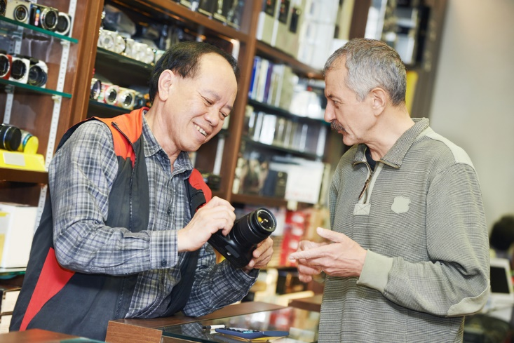
Evaluate the information generated by the trial
Possible positive economic impacts:
Increased employment opportunities for local population
Increased investment in the local area
Increased local revenue
Notes:
Trainer discusses possible positive economic impacts:
Increased employment opportunities for local population – giving:
Higher levels of disposable income
Improved standards of living from a material perspective
Increased investment in the local area – which:
Generates all the benefits of the multiplier effect
Tends to be self-perpetuating in that one lot of investment often attracts more investment from other parties
Increased local revenue – which has flow-on effects on:
Foreign exchange earnings
Taxation
Local spending potential on local facilities.

Slide 78

Evaluate the information generated by the trial
Possible negative economic impacts:
Potential for unacceptable levels of inflation
Diversion of a country’s limited funds from other necessary projects towards tourism activities
Problems resulting from ‘too much’ reliance on tourism income when there is tourism down-turn
Notes:
Trainer discusses possible negative economic environmental impacts:
Potential for unacceptable levels of inflation – as prices of local commodities (food, housing, land, resources) increase as a result of the standard economic ‘supply and demand’ principle
Diversion of a country’s limited funds from other necessary projects towards tourism activities – thereby causing increased hardship on locals
Problems resulting from ‘too much’ reliance on tourism income when there is an unexpected and dramatic downturn in tourist numbers/spending.

Slide 79

Evaluate the information generated by the trial
Possible positive cultural impacts:
Sharing of culture with the wider community
Better understanding of culture amongst other communities
Notes:
Trainer discusses possible positive cultural impacts:
Sharing of culture with the wider community – which can bring greater recognition to communities regarding their rites, celebrations and their unique nature which serves to generate greater interest in the area and attract more tourists,
Better understanding of culture amongst other communities

Slide 80
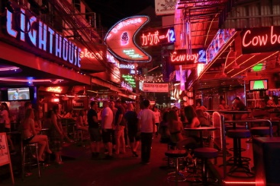
Evaluate the information generated by the trial
Possible negative cultural impacts:
Trivialisation of the culture
Offence (often unintended) given to locals by the comments, dress and behaviour of visitors
‘Westernisation’ of culture
Notes:
Trainer discusses possible negative cultural environmental impacts:
Trivialisation of the culture – and exploitation of it for commercial gain and to satisfy the interests of outsiders
Offence (often unintended) given to locals by the comments, dress and behaviour of visitors
Potential for established culture to be altered against the will of and despite the activities of the local community – such as the so-called ‘Westernisation’ of communities and a diminution on the importance of family.
Classroom Activity – Internet Research
Trainer facilitates research and discussion of:
http://unesdoc.unesco.org/images/0018/001826/182646e.pdf - The effects of tourism on culture and the environment in Asia and the Pacific
http://www.slideshare.net/ejaysamson/sociocultural-impacts-of-tourism - Socio-cultural impacts of tourism.

Slide 81

Utilise information from trial to modify plans to optimise impacts
Following evaluation of a trial it is important to understand:
Findings of evaluation must be used to guide future action
Involvement of stakeholders must continue
There can be a need to run a supplementary trial
Notes:
Trainer highlights following the evaluation of a trial it is important to understand:
The findings of the evaluation must be used to guide future action – these finding cannot be ignored and must not be manipulated to make them fit/accommodate pre-determined ends or objectives
Involvement of stakeholders must continue – their inclusion in the project needs to be of an ongoing and remain characterised by transparency and honesty
There can be a need to run a supplementary trial – where the evidence and/or evaluation proved to be:
Lacking the detail required in relation to the identified criteria and parameters
Insufficient to allow decisions to be made
Significantly controversial
Obviously flawed.

Slide 82
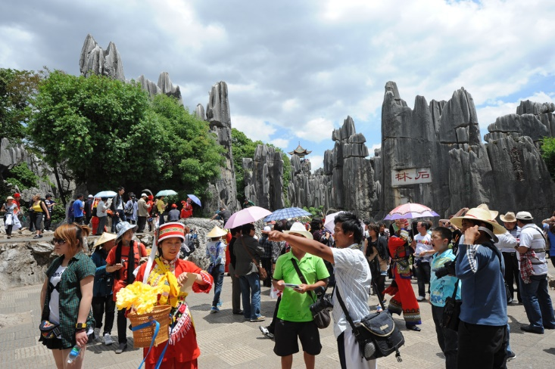
Utilise information from trial to modify plans to optimise impacts
Based on findings of the trial there can be a need to:
Cancel the proposed activity/operation
Revise aspects of the plan that were highlighted as negative as a consequence of the trial
(Continued)
Notes:
Trainer indicates it is possible, based on the finding of the evaluation of the trial there can be a need to:
Cancel the proposed activity/operation – Tourism Operators must be prepared to do this if the data from the trial indicates the initiative:
Will have significant/unacceptable impacts on the area and/or local community
Does not have necessary support
Revise aspects of the plan that were highlighted as negative as a consequence of the trial – this can necessitate:
Altering the types and nature of tour activities
Shifting the physical location of routes, sites used and/or interpretive activities
Varying the size or scope of the proposal
Changing timing considerations
Increasing the amount of investment
Using different personnel

Slide 83

Utilise information from trial to modify plans to optimise impacts
Constrain the impact of the plans
Expand plans for those aspects of the plan that received a positive trial result
Gain necessary approvals and authorisations from stakeholders for revised plans to be developed
Notes:
Trainer continues to identify possible action required following trial:
Constrain the impact of the plans – by:
Reducing the area/s visited or involved in the initiative
Lowering numbers in tour groups
Visiting the area on a less frequent basis
Conducting fewer interpretive activities
Restricting vehicle access
Expand plans for those aspects of the plan that received a positive trial result – which may mean:
Increasing the duration of tours
Extending the initiative into other areas
Raising tour group numbers
Including extra interpretive activities
Creating additional sustainable initiatives to be trialled in the same location
Gain necessary approvals and authorisations from key stakeholders for any revised plans which are to be developed – following the same consultative process which has been used to-date.

Slide 84

Summary – Element 2
When trialling minimal impact operations:
Verify plan for the pilot has been approved
Implement the trial strictly in accordance with the plan
Provide necessary information, training, resources and infrastructure to enable the trial
(Continued)
Notes:
Trainer provides a recap of the Element asking questions to check trainee understanding and responding to questions from trainees, as required.

Slide 85

Summary – Element 2
Provide necessary monitoring training and resources
Communicate the plan for the trial to those who have responsibilities for action under the plan
Involve stakeholders
(Continued)
Notes:
Trainer provides a recap of the Element asking questions to check trainee understanding and responding to questions from trainees, as required.

Slide 86

Summary – Element 2
Establish initial benchmarks
Gather monitoring data/information to address identified evaluation criteria and parameters
Follow-up as required to ensure sufficient, reliable and valid data is captured
(Continued)
Notes:
Trainer provides a recap of the Element asking questions to check trainee understanding and responding to questions from trainees, as required.

Slide 87

Summary – Element 2
Evaluate evidence obtained as a result of the approved monitoring activities
Modify trial plans on the basis of data gathered and decisions made following analysis the data
Seek to optimise positive impacts and reduce/eliminate negative impacts
Notes:
Trainer provides a recap of the Element asking questions to check trainee understanding and responding to questions from trainees, as required.

Slide 88

Element 3 – Implement minimal impact operations
Performance Criteria for this Element are:
Apply revised plans to the practical application of minimal impact tourism activities/operations
Conduct the activity/operation in such a way that encourages others to engage in minimal impact actions
Implement ongoing monitoring protocols
Notes:
Trainer identifies for trainees the Performance Criteria for this Element, as listed on the slide.
Class Activity – General Discussion
Trainer leads a general class discussion by asking questions such as:
What might be important considerations involved in implementing minimal impact tourism operations?
What do you think would be keys in the process?
What pre-requisites should preceded this stage?
Who would be involved?

Slide 89
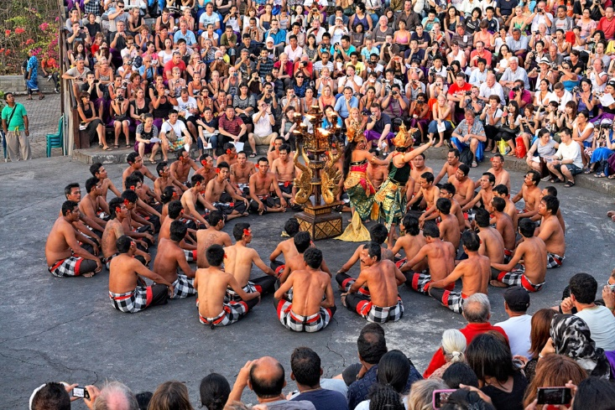
Apply revised plans to practical application of minimal impact tourism activities/operations
When applying the revised plans for the sustainable tourism initiative it is vital to:
Confirm the plan has been revised and approved for implementation by relevant stakeholders
Share the revised plans
Implement the plans as revised
(Continued)
Notes:
Trainer notes when applying the revised plans for the sustainable tourism initiative it is vital to:
Confirm the plan has been revised and approved for implementation by relevant stakeholders – this can mean:
Sighting an appropriately signed document
Attending a stakeholder meeting and obtaining permission/vote to proceed with the revised plan
Share the revised plans – which can require:
Involving the media by advising them of progress
Inviting media to participate in a reviewed activity
Going into local communities to talk to them and distribute copies of new plans
Communicating revised plans to general public – by (for example) posting on organisational website, and advertising in the media
Implement the plans as revised – which means:
Adhering strictly to the requirements of the revised plan
Not straying off track and ‘inadvertently’ returning to actions and activities in the draft/pilot plan
Resourcing activities as necessary to ensure the plan for the initiative can be applied as intended
Using nominated personnel, communities, locations, activities, access routes, dates and times

Slide 90

Apply revised plans to practical application of minimal impact tourism activities/operations
Use minimal impact techniques
Align with the six ASEAN Tourism Standards
Liaise frequently with key stakeholders
Notes:
Trainer continues to identify requirements when implementing revised plans:
Use minimal impact techniques – these will depend on the individual initiative but can involve or provide opportunity for:
Providing suitable education on appropriate behaviour for tour leaders/staff and tour group members
Undertaking necessary site hardening to enable sites to cater for the known or expected visitor numbers – this may involve construction of buildings, putting hard surfaces on tracks to protect against erosion, or surfacing of roads,
Applying technological solutions to identified problems – as appropriate to each type of challenge/difficulty identified: which may involve for example:
use of solar energy to provide power
use of ICT and mobile technologies to disseminate/provide visitor information – instead of paper-based materials/handouts
Restricting or limiting access to sites and areas
Staged authenticity – where events and activities are re-created in a managed/controlled way and presented as an ‘authentic’ representation of the real/actual event/s thus:
protecting the privacy of local communities
enabling issues relating to unwanted intrusion to be dealt with
allowing more people/’everyone’ to see or experience the event/s ,
Align with the six ASEAN Tourism Standards – as described previously
Liaise with key stakeholders by communicating frequently with them via meetings and other identified/preferred methods of contact – to:
Ensure ongoing support and positive relationships
Solicit stakeholders feedback and input
Share problems and issues
Obtain help from stakeholders to resolve problems
Communicate progress reports
Respond appropriately to problems and comments.

Slide 91

Conduct operation in a way that encourages others to engage in minimal impact actions
Reasons to conduct sustainable tourism initiatives in a way that encourages others to do the same:
Demonstrate the professionalism of the organisation
Show genuine commitment to ‘sustainability’
Demonstrate transparency
(Continued)
Notes:
Trainer explains there is a need to conduct sustainable tourism initiatives in a way that encourages others to do the same in order to:
Demonstrate the professionalism of the organisation – to the wider community
Show genuine commitment to ‘sustainability’ – by doing ‘a little bit extra’ than the minimum that is required
Demonstrate transparency – in the entire implementation process by proving the organisation is prepared to let other see what they are doing

Slide 92

Conduct operation in a way that encourages others to engage in minimal impact actions
Prove organisational interest in ‘sustainability’ is ongoing
Attract public attention to areas/issues of concern
Promote ‘Six ASEAN Tourism Standards’
Provide basis for making positive public statements about the organisation and its ‘sustainable’ credentials
Notes:
Trainer continues to explain reasons to conduct sustainable tourism initiatives in a way that encourages others to do the same:
Prove organisational interest in ‘sustainability’ is ongoing – and not just focussed on this initiative
Attract public attention to the areas/issues of concern – and highlight how these are being effectively addressed
Promote the ‘Six ASEAN Tourism Standards’ – and related policies
Provide a truthful basis for making positive public statements about the organisation and its ‘sustainable’ credentials – in advertisements and on the website.

Slide 93

Conduct operation in a way that encourages others to engage in minimal impact actions
Strategies to encourage others to engage with ‘sustainability’:
Acting as a role model for action
Sharing lessons learned
Becoming an advocate for sustainability
Using the media to spread the word
Notes:
Trainer presents strategies to encourage others to engage with ‘sustainability’:
Acting as a role model for action – by, for example:
Taking responsible decisions; Putting the planet before profit; Involving stakeholders and local communities
Listening to stakeholders and local communities; Responding to stakeholders and local communities by altering plans – and, where necessary, abandoning project/s
Sharing lessons learned with industry, government agencies and other Tourism Operators – which may involve:
Posting information on a public website; Distributing reports, evaluations and findings; Actively helping others who wish to commence a sustainable tourism project
Becoming an advocate for sustainability – and, perhaps:
Speaking on behalf of ‘sustainability’ at public meetings and industry events
Talking about the benefits which have flowed from having taken a ‘sustainable’ approach to tourism projects
Using the media to spread the word about sustainable tourism – in the form of:
Writing articles for local newspapers or magazines on sustainable tourism and how it may be achieved
Writing articles on the benefits to operators of engaging with sustainable tourism
Doing radio and television interviews on a range of ‘sustainable tourism’ topics
Involving media in initiative and inviting them to participate ‘free of charge’ in exchange for some media exposure
Developing press releases on a different ‘sustainability’ topics and the progress of the initiative/s.
Classroom Activity – Guest Speaker
Trainer arranges for local media representative to attend and:
Discuss how the media can help/become involved with sustainability
Describe the relationship which could/should exist between a Tourism Operator and the media explaining how this can be established
Illustrate how the media can help the tourism industry and how the industry can help the media
Identify requirements/arrangements for obtaining media coverage of an event or initiative.

Slide 94

Implement ongoing monitoring protocols
Keys to implementing monitoring protocols:
Check necessary training has been delivered
Verify all required resources have been supplied as promised
Ensure technologies used and confirmed in the pilot are used
(Continued)
Notes:
Trainer presents keys to implementing monitoring protocols:
Check necessary training has been delivered – to all allocated responsibilities for monitoring activities and data gathering
Verify all required resources have been supplied as promised – to enable identified monitoring to occur and be recorded as planned
Ensure technologies used and confirmed in the pilot are used – or varied as required on basis of evaluation. This may require:
Using different technology/systems to gather data
Gathering data at different/more frequent times
Obtaining different data.

Slide 95

Implement ongoing monitoring protocols
Take action to make sure agreed ‘other’ monitoring activities are being undertaken as planned
Follow-up with those who have responsibility for monitoring activities – as required
Be actively, personally involved to show there is real engagement with the project, genuine desire to monitor impacts and hands-on management
Notes:
Trainer continues to present keys to implementing monitoring protocols:
Take action to make sure the agreed ‘other’ monitoring activities are being undertaken as planned – by the people who have been designated and with the required frequency. This relates to the activities such as personal observations, entries in log books/note books, taking of still and moving images, surveying of land used and similar
Follow-up with those who have responsibility for monitoring activities – as required. This may be a commo requirement because many of the data collectors are often unpaid volunteers. Follow-up may be required:
If no monitoring information/data is being received
Where there are requests for help
If problems arise
Where there is significant variation in the data received from what is normally obtained, or from what is expected
Be actively and personally involved to show those involved (and others) there is real organisational engagement with the project, genuine desire to monitor the impacts and hands-on management of the project – this may be achieved by:
Helping personnel with their data gathering/monitoring activities
Showing people how to optimise their information gathering
Providing a visible on-site presence
Actually doing some data gathering.

Slide 96

Summary – Element 3
When implementing minimal impact operations:
Apply the approved and revised plans to the implementation of the initiative – follow the plan
Confirm extra/different resources and training have been provided
Align with ASEAN Tourism Standards
Be a role model for minimal impact tourism operations
(Continued)
Notes:
Trainer provides a recap of the Element asking questions to check trainee understanding and responding to questions from trainees, as required.

Slide 97

Summary – Element 3
Share lessons learned with relevant others
Advocate for sustainable tourism
Gather required monitoring data as an integral part of implementation
Actively seek and then record feedback on the initiative
Notes:
Trainer provides a recap of the Element asking questions to check trainee understanding and responding to questions from trainees, as required.

Slide 98

Element 4 – Evaluate minimal impact operations
Performance Criteria for this Element are:
Collect objective environmental data
Solicit feedback from the local community and staff
Collaborate with local authorities to manage local environmental and social issues caused by, or related to, the minimal impact activity/operation
Modify previous plans on the basis of valid data obtained
Notes:
Trainer identifies for trainees the Performance Criteria for this Element, as listed on the slide.
Class Activity – General Discussion
Trainer leads a general class discussion by asking questions such as:
Why is there a need to evaluate the sustainability initiatives?
Who is involved in the process?
When and where does the evaluation occur?
What are the possible outcomes?
How binding are the findings of the evaluation?

Slide 99

Collect objective environmental data
Collecting data must occur as planned – if it does not:
Opponents of the initiative may seize on this as ‘evidence’ the organisation has something to hide
The validity of the entire project starts to be questioned
The credibility of the organisation suffers as people start thinking ‘they only said they were going to do it in order to get approval to proceed’
Notes:
Trainer explains the necessity of implementing the planned data gathering procedures exactly as planned and agreed to by stakeholders cannot be stressed too highly emphasising whatever was presented as being planned data gathering procedures must be undertaken.
As soon as a proponent starts to deviate from the planned data gathering procedures:
The opponents of the initiative may seize on this as ‘evidence’ of the organisation having something to hide
The validity of the entire project starts to be questioned – if this needs changing, what else might also be wrong/need changing or is going to be changed?
The credibility of the organisation suffers as people start thinking ‘they only said they were going to do it in order to get approval to proceed: not why have gained their approval they are not going to do what they promised’.

Slide 100

Collect objective environmental data
If there is a need to vary original arrangements:
Communicate promptly with stakeholders
Explain in detail the need for variation
Provide evidence of need for change
Present and explain proposed amendments
(Continued)
Notes:
Trainer indicates if it ever emerges there is a legitimate need to vary the planned data gathering procedures the procedure for achieving this should involve:
Prompt communication with stakeholders
Detailed description of the need for the change
Provision of supporting data/evidence of the need for change
Presentation of changes intended explaining why and how they will achieve the objective/s described in the ‘need for change’

Slide 101
Collect objective environmental data
Request approval for change
Allocate new responsibilities for implementing revised protocols
Provide required resources and training
Integrate new requirements into remaining original plan
Notes:
Trainer continues to explain action to take if there is a need to change agreed monitoring arrangements:
Request for approval for the identified changes to be implemented
Allocation of responsibilities for new data gathering procedures
Provision of necessary training an resources
Integration of new strategies into established other monitoring activities.

Slide 102

Collect objective environmental data
When monitoring, collect:
Qualitative and quantitative data
Objective data – quantifiable and fact-based
Subjective data – about personal feelings, thoughts and perceptions
Notes:
Trainer highlights there is always a need to collect qualitative and quantitative data as a part of the monitoring for any sustainable tourism initiatives.
The collection of quantitative data includes the gathering of objective environmental data.
‘Objective’ data is data is fact-based data free of personal bias, influence, opinion or thought – it is information gained as a result of some form of testing. It refers to data which is measurable and observable.
By contrast, ‘subjective’ data is personal opinion, thoughts, perceptions and feelings.

Slide 103

Collect objective environmental data
Objective data may be gathered through:
Doing personal observation/s
Conducting tests
Undertaking physical examinations
(Continued)
Notes:
Trainer notes objective data may be captured as a result of:
Personal observation – of visible and measurable actions such as (for example):
Number of people who visit a site or use a facility
Length of time people spend at a location
Number of vehicles that use a road or enter an area
Conducting tests – which may seek to track statistical evidence of what happens when (for example):
There is a change in routes taken by tour groups
Interpretive activities provided to a group are altered
The arrival and departure times of a tour/group are varied
Undertaking a physical examination of land or an area or other nominated site or object – such as:
Counting the number of a species in a designated area
Monitoring re-generation activities
Measuring waste.

Slide 104

Collect objective environmental data
Reading meters/equipment, such as:
Water quality meters and air monitors
Dust monitors and soil samplers
Sound level meters and vibration monitors
Thermometers
Water depth and flow gauges
Traffic meters and pedestrian turnstiles
Notes:
Trainer continues to indicate ways to capture objective data:
Reading the meters or print-outs of technical equipment/technology which has been bought or rented for the purpose of the project – such as:
Hand-held water quality meters
Air monitors
Dust monitors
Soil samplers
Sound level meters
Vibration monitors
Thermometers
Water depth and flow gauges
Traffic (road count) meters
Turnstiles.
Classroom Activity – Guest Speaker
Trainer arranges for representative from commercial monitoring organisation to attend and:
Identify equipment and services they can provide in relation to a tourism initiative
Present and demonstrate use of equipment, monitors and meters
Provide advice on monitoring tourism initiatives and collecting data.

Slide 105

Collect objective environmental data
Considerations when collecting data:
Try to involve stakeholders/local communities
Supplement use of local communities and stakeholders with recognised professional, external consultant/s
Verify testing and monitoring equipment has been correctly calibrated
Follow-up as required
(Continued)
Notes:
Trainer presents considerations when collecting data:
Try to involve stakeholders/local communities – in order to:
Give them a sense of ownership in the initiative
Demonstrate inclusivity and collaboration
Prove openness and transparency of the project
Supplement use of local communities and stakeholders with the use of a recognised professional, external consultant – who has experience with tourism initiatives and environmental monitoring, so they:
Can provide important third party reports for the project
Assist volunteers in their monitoring activities
Identify the need for ‘other’ monitoring activities to be introduced to the operation as the initiative unfolds
Advise of concerning issues at the earliest possible time
Verify the testing and monitoring equipment has been correctly calibrated – which may require:
Getting all hand-held monitors used by volunteers or project staff are tested/calibrated and certified prior to use so their readings can be deemed ‘reliable and accurate’
Obtaining written proof (such as a Certificate of Confirmation) from third party consultants that their equipment has been appropriately verified and certified for use as intended
Follow-up as required – that is, communicating with those who have been allocated data collection responsibilities if:
Have a query or a problem and need assistance
Their data is not received as and when expected
Data provided by them is incorrect or insufficient for the intended purpose, as explained to them during their training

Slide 106

Collect objective environmental data
Physically collect the data
Collate the data
Manipulate the data
Share the data and the findings
Notes:
Trainer continues to present considerations when collecting data:
Physically collect the data – which may require:
Travelling to sites to read meters and equipment
Obtaining hard copy sheets of data from on-site collectors
Using telemetry connected to metering devices to obtain readings remotely
Liaising with consultants to capture their information
Retrieving data sent electronically (or otherwise) to a designated site/location – such as by email, posting to a site, text, any digital platform or mail
Collate the data – by:
Assessing it to determine exactly what the data is about/what it represents or refers to
Entering the information provided into prescribed ‘fields’ in a paper-based or electronic database
Manipulate the data – which traditionally involves:
Performing addition, subtraction, multiplication, division to generate relevant totals, percentages, and ratios
Identifying trends which emerge from the data
Drawing distinctions and comparisons between ‘before’ and ‘after’ data
Generating findings from the data based on statistical/fact-based evidence
Share the data and the findings – through a blend of approaches appropriate to the project, which may include:
Stakeholder meetings and public meetings
Press releases and interviews with the media
Electronic and/or paper based distribution of information
Posting information on a nominated website
Encouraging comment and feedback.

Slide 107

Solicit feedback from the local community and staff
Feedback may be:
Provided verbally or in writing
Positive and/or negative
Offered voluntarily and/or need to be sought out
Given by an individual or a group
A mandatory requirement from some stakeholders
Notes:
Trainer gives context by noting feedback may be:
Provided verbally or in written form – the organisation must be prepared to record oral feedback and capture it in written or electronic form
Positive or negative – the organisation cannot choose to only believe the positive/good feedback it receives because many valid and important points are raised as a result of negative feedback
Offered willingly without having to be requested or sought out – or it may need to be asked for
Given by a person or a group – some individuals prefer the anonymity of contributing feedback by being part of a larger cohort of people
‘Compulsory’ – while communities may make input based on their inherent involvement in the initiative and the way it is likely to impact them, others (staff, consultants, paid members of the local community) may be ‘required’ to submit feedback as part of the arrangement that is made with them.

Slide 108

Solicit feedback from the local community and staff
Ways to encourage feedback:
Make people aware from the outset that feedback is being sought
Maintain a feedback database/file
Proactively seek feedback
(Continued)
Notes:
Trainer present ways to encourage feedback:
Make people aware from the outset that feedback is being sought – and that the organisation:
Welcomes it
Provides mechanisms for people to provide it
Values it
Will take notice of it
Maintain a feedback database/file – so all feedback provided and/or captured is recorded and can be classified and used:
To guide ongoing actions to achieve a minimal impact result
As part of the evaluation process
Proactively seek feedback – the organisation must not only signal their initial desire for feedback but they must also:
Ask for it at all meetings
Supply forms for people to complete to record their contributions
Apply questionnaires and surveys
Hold focus groups with tour group members, local communities and other involved parties
Conduct consultation and feedback meetings

Slide 109

Solicit feedback from the local community and staff
Thank people for contributions
De-brief with staff who have been involved
Meet on-site with other parties which may be done by integrating them into a standard tour group or holding a dedicated tour/activity just for them
Sharing the feedback
Notes:
Trainer continues to present ways to encourage feedback:
Thank people for making contributions – because this:
Is polite and respectful
Generates moiré feedback
Demonstrates the positive orientation of the organisation to feedback even if it is negative comment
De-brief with staff who have been involved with the activity – which can occur:
Face-to-face at the conclusion of tours or activities
At staff meetings and briefings
Through the completion of mandatory Reports to be compiled at the end of each tour or activity
Meet on-site with other parties which may be done by integrating them into a standard tour group or holding a dedicated tour/activity just for them – to:
Enable them to experience the initiative first-hand – as opposed to them thinking they know what the activity/operation is all about
Seek and record their impressions as they experience the initiative, and at the conclusion of the activity
Sharing the feedback – with key stakeholders:
Verbally
Electronically
Using hard copy information.

Slide 110

Collaborate with local authorities to manage issues caused by, or related to, the activity
Things to note/be aware of:
Tourism Operators have a commercial imperative
Impacts can be positive or negative – for all classifications o stakeholders
(Continued)
Notes:
Trainer provides context observing:
The Tourism Operator has a commercial objective – that is, they want to make money and obtain a satisfactory ROI from the project
This is just a simple fact of business life but it often runs contrary to the aims of other stakeholders
Impacts can be positive or negative – not all outcomes will be advantages to a community but nor will they necessarily all be bad.

Slide 111

Collaborate with local authorities to manage issues caused by, or related to, the activity
Different people have different perspectives and priorities
Issues and impacts vary over time and between different projects
An organisation that is genuine in its orientation to minimal impact tourism operations must be prepared to walk away from an initiative when it is obvious the impacts of the proposal are just too severe
Notes:
Trainer continues to provide context noting:
Different people have different perspectives and priorities – what is important for one person/group is not necessarily what is important for another person/group
The key is often to find a consensus outcome (which often needs to be negotiated – that is, there needs to be ‘give and take’ between the parties) which satisfies all those who are interested or impacted
Issues and impacts vary over time and between different projects – based on factors which are relevant to the project and/or that apply ‘at the time’
In practice, no two minimal impact tourism initiatives are the same even though they may appear similar and even though some lessons learned from one operation can be successfully transferred/applied to another project
An organisation that is genuine in its orientation to minimal impact tourism operations must be prepared to walk away from an initiative when it is obvious the impacts of the proposal are just too severe – this is the only sensible and responsible thing that can be done
Abandoning/cancelling a project for this reason may be costly to the organisation but it has benefits in terms of its industry reputation and the credibility such a decision will create with customers, government agencies and local communities generally
Such a decision also tends to make future minimal impact tourism initiatives much easier to plan, trial and implement.

Slide 112

Collaborate with local authorities to manage issues caused by, or related to, the activity
Four basic options at this stage:
Abandon the project – walk away/close it down
Do nothing – maintain the same protocols
(Continued)
Notes:
Trainer identifies the four basic options at this stage:
Abandon the project – which may require:
Removing structures and/or infrastructure built in the location on a permanent/temporary basis for the initiative (or these may remain as a donation/gift by the Tourism Operator to the local community, if agreeable to both parties)
Re-generating damaged or impacted land
Replenishing depleted resources
Paying compensation to the local community
Do nothing – which means, for example:
Continue running tours as previously done
Employ the same people
Visit/conduct activities in the same location with the same frequency
Maintain visitor/tour/activity numbers

Slide 113

Collaborate with local authorities to manage issues caused by, or related to, the activity
Capitalise on positive outcomes
Reduce or eliminate the impact of negative outcomes
Notes:
Trainer continues to discuss basic options at this stage:
Capitalise on any positive outcomes – which may involve, for example:
Building extra buildings or roads
Employing more people
Conducting more tours or activities
Expanding the area used by the pilot program and subsequent activities
Increasing the duration of tours/activities
Transferring the initiative to another site/community
Reduce/eliminate all negative outcomes – which may require action such as:
Re-locating elements of tour/activity to different geographic site – to preserve sites which are getting damaged
Lowering interaction between tour groups and aspects of the site/local community’ – so there is less social impact
Reducing frequency and/or the number of tourists in each group – to lower the likelihood of negative outcomes
Restricting tour/activity site – by limiting activities and routes to more confined areas which will again protect delicate areas and reduce the potential for negative social impacts
Altering inclusions – so environmental concerns are addressed by removing interaction with (for example) a threatened geographical feature or a natural feature which has shown adverse readings in the monitoring process
Changing Code of Behaviour for tourists who engage with the local community as part of the tour/activity – so the revised requirements address issues which are causing damage or offence to the social structure of the community
Negotiating a trade-off with the local community – whereby they may be paid for things which have had a harmful impact on them, or be given (for example) assistance in terms of medical help, food, clothing, buildings, fuel or other goods and services deemed by them to be necessary and appropriate.

Slide 114

Collaborate with local authorities to manage issues caused by, or related to, the activity
Activities in the collaboration process:
Attend all meetings convened by local authorities
Provide requested all information/data to local authorities
Fund the management process
Honour promises made about what the organisation would do if monitoring revealed a certain outcome
(Continued)
Notes:
Trainer identifies activities in the collaboration process:
Attend all meetings convened by the local authorities – to demonstrate engagement and willingness with this stage of the process
Provide requested all information/data to the local authorities – as, how and when requested
Fund the management process – which may entail:
Pay for required changes to be paid
Pay nominated persons to attend/participate in the management process
Supply food and beverages and other support resources for the conduct of meetings and related other actions
Adhere to and honour any previous promises made about what the organisation would do if the monitoring process revealed a certain outcome – the Tourist Operator must remain ‘true to their word’

Slide 115

Collaborate with local authorities to manage issues caused by, or related to, the activity
Listen to what those who disagree have to say
Be open and transparent when discussing issues
Be hard but be fair
(Continued)
Notes:
Trainer identifies activities in the collaboration process:
Listen to what those who disagree have to say – because it may be the case they have a valid point which needs to be addressed
Be open and transparent when discussing issues – this can mean:
Showing actual evidence gathered
Making all information/data available – which may mean releasing information which may be regarded as damaging to the Tourist Operator
Be hard but be fair – the management process is not one where the Tourist Operator just accepts what everyone else says and does what everyone else wants, but is one where:
They are entitled to have their say and argue their point
They should present evidence to support their case/their side of the argument
They are free to contest ill-informed or incorrect points which are raised by opponents of the initiative

Slide 116

Collaborate with local authorities to manage issues caused by, or related to, the activity
Conduct additional research and/or monitoring
Record discussions and findings
Share deliberations, discussions and decisions
Make suggestions for action
Notes:
Trainer continues to identify activities in the collaboration process:
Conduct additional research and/or monitoring – as/if required to obtain more or different data to enable an informed decision to be made about a topic which is proving to be challenging or difficult to reconcile
Record the discussions and findings – for future reference so there is a true and accurate record of:
When meetings were conducted, where they occurred and who attended
What was said and discussed
Who said what
Votes that were taken and the results of the votes
Share the deliberations, discussions and decisions – so:
All stakeholders are aware of the process and know what took place
Transparency of decision making can be maintained
Make suggestions for action – this must be done to accommodate the identified issues and concerns raised by the initiative but also needs to be done in a way that:
Meets the commercial imperatives of the Tourist Operator
Demonstrates the professionalism and industry knowledge and expertise of the Operator
Optimises the potential for future minimal impact tourism to be well received.

Slide 117

Modify previous plans on the basis of valid data obtained
Changes made to plans:
Must address identified need
Must be in writing
Must be integrated into the rest of the original plan
(Continued)
Notes:
Trainer gives context for this step observing the changes which are made to the plans:
Must address identified need
Must be put in writing
Must be integrated into the existing plan

Slide 118

Modify previous plans on the basis of valid data obtained
Must be evidence-based
Must be approved by management team
Must be communicated to stakeholders
Notes:
Trainer continues to give context for this stage observing changes:
Must be based on actual/factual evidence
Must be approved by those in the project management team
Must be communicated with relevant stakeholders and with those who have responsibility allocated to them under the revised plan.

Slide 119

Modify previous plans on the basis of valid data obtained
Changes may include:
Changing the type/nature of the operation, project, activity or initiative
Changing the interpretive activities included
Changing the physical/geographic location of the initiative
(Continued)
Notes:
Trainer identifies changes to plans may include:
Changing the type/nature of the operation, project, activity or initiative – which may mean:
Giving the initiative a different focus
Targeting a different market
Promoting in a different way
Changing the interpretive activities included – so activities which are causing problems are replaced by ones:
Likely to cause less of an impact
More acceptable to local communities
Changing the physical/geographic location of the initiative – such that an acceptable tour/activity is re-located to an area which causes less unacceptable impact/s

Slide 120

Modify previous plans on the basis of valid data obtained
Changing inclusions
Using different tour staff and volunteer workers/local community people
Altering timing of tours/activities
Adjusting size and/or composition of group
(Continued)
Notes:
Trainer continues to identify changes to plans may include:
Changing inclusions – so that inclusions causing problems are removed and (perhaps) replaced by a more acceptable alternative, for example:
Replacing a 5-day camp with an overnight stay
Replacing the distribution of pre-prepared F&B to tour group members with freshly-cooked food prepared by locals (for which they are paid)
Adding a local artifact as a ‘free gift’ from the Tourist Operator as part of the package (which is purchased from local artisans)
Using different tour staff and volunteer workers/local community people – where there appears a need for:
A different blend of workers
People with new/different skills and expertise
More people to help control visitors and monitor impacts
Altering timing of tours/activities – in terms of:
Seasons and/or dates for tours/activities
Frequencies of tours/activities
Arrival and departure times
Start and finish times for activities
Keeping the same activities but varying the sequence of things
Adjusting the size and/or composition of tourists and visitors – such that, for example:
Group numbers/participant numbers are reduced
Babies/young people are prohibited
Local sensitivities regarding age and gender are respected

Slide 121

Modify previous plans on the basis of valid data obtained
Limiting locations tourists can enter
Reducing or increasing participation of local community and roles they play
Revising visitor ‘Code of Conduct’
(Continued)
Notes:
Trainer continues to identify changes to plans may include:
Limiting the locations tourists can enter – when they are physically in the local community, so that, perhaps:
Certain houses or buildings are ‘off limits’
Prescribed walking routes must be adhered to
Time limits are applied to the length of time to be spent in nominated locations
Nominated activities are banned in prescribed areas
Reducing or increasing participation of the local community and the roles they play within activities – which can mean:
Local people may be employed as part of the crew/team for a tour in positions such as food preparation and cooking, food and beverage service, entertainment, local guides, presenters of interpretive activities
External workers are brought in to replace positions previously filled by local people
Revising required Code of Conduct that will be communicated to visitors prior to their engagement with the local community – with common changes being made to topics addressing:
Dress
Behaviour
Respect for communities
Language used
Local customs to be observed

Slide 122

Modify previous plans on the basis of valid data obtained
Increasing amount and/or type of resources allocated
Changing supporting/underpinning infrastructure
Changing monitoring protocols for nominated issues/topics
Changing delivery method for information
Notes:
Trainer continues to identify changes to plans may include:
Increasing the amount and/or type of resources allocated to the operation – there is commonly never a need to reduce the amount or type of resources committed to an initiative, but there can be a need to:
Employ more staff
Use different staff – and/or provide nominated training to staff
Pay local communities more money
Acquire and use more physical items
Changing the supporting/underpinning infrastructure – in that there can be a need to:
Create more tracks roads
Upgrade, grade or seal tracks
Erect more buildings
Construct additional landing areas for water craft and aircraft
Build toilets, camp sites, kitchen and dining facilities, accommodation and other support structures
Changing the monitoring protocols for nominated issues/topics – which can involve:
Adding new technologies/metering to monitor new topics/environmental concerns
Taking readings at more frequent intervals
Obtaining readings/monitoring data from different sites
Changing the delivery method for information – and, as necessary:
Using a more technology-reliant option rather than, say, a human to provide a commentary/information
Allowing (for example) self-discovery to replace lectures, displays and presentations.

Slide 123

Summary – Element 4
When evaluating minimal impact operations:
Make sure the data identified as being gathered is in fact captured and recorded
Involve stakeholders
Use objective and subjective as required to evaluate the initiative
(Continued)
Notes:
Trainer provides a recap of the Element asking questions to check trainee understanding and responding to questions from trainees, as required.

Slide 124

Summary – Element 4
Solicit feedback from those involved – staff, tourists, local communities, other stakeholders
Conduct evaluations and manipulate data with reference to established criteria and parameters
Use external consultants/professionals where necessary
(Continued)
Notes:
Trainer provides a recap of the Element asking questions to check trainee understanding and responding to questions from trainees, as required.

Slide 125

Summary – Element 4
Make decisions based on actual data
Share and/or publish the data and findings
Work cooperatively with local communities to address their concerns
Adjust plans to reflect the findings of the evaluation
Notes:
Trainer provides a recap of the Element asking questions to check trainee understanding and responding to questions from trainees, as required.
Trainer thanks trainees for their attention and encourages them to apply course content as required in their workplace activities.

